Slide 1
Trusting
the Most High God
in perilous times
Daniel series: Kingdoms to Come
2:24-49

Slide 2
²⁴ Therefore, Daniel went in to Arioch, whom the king had appointed to destroy the wise men of Babylon; he went and spoke to him as follows: "Do not destroy the wise men of Babylon! Take me into the king's presence, and I will declare the interpretation to the king." ²⁵ Then Arioch hurriedly brought Daniel into the king's presence and spoke to him as follows: "I have found a man among the exiles from Judah who can make the interpretation known to the king!"
Daniel 2:24-25 NASB

Slide 3
Daniel 2:26-30 ²⁶ The king answered and said to Daniel, whose name was Belteshazzar, "Are you able to make known to me the dream which I have seen and its interpretation?" ²⁷ Daniel answered before the king and said, "As for the mystery about which the king has inquired, neither wise men, conjurers, magicians, nor diviners are able to declare it to the king. ²⁸ "However, there is a God in heaven who reveals mysteries, and He has made known to King Nebuchadnezzar what will take place in the latter days. This was your dream and the visions in your mind while on your bed. ²⁹ "As for you, O king, while on your bed your thoughts turned to what would take place in the future; and He who reveals mysteries has made known to you what will take place. ³⁰ "But as for me, this mystery has not been revealed to me for any wisdom residing in me more than in any other living man, but for the purpose of making the interpretation known to the king, and that you may understand the thoughts of your mind.

Slide 4
Thou, O king, sawest, and behold, a great image. This image was mighty and its brightness excellent; it stood before thee, and its appearance was terrible.
Daniel 2:31 DBY

Slide 5
Thou, O king, sawest, and behold, a great image. This image was mighty and its brightness excellent; it stood before thee, and its appearance was terrible.
Daniel 2:31 DBY
Art by Erin Kelley

Slide 6
³² "The head of that statue was made of fine gold, its breast and its arms of silver, its belly and its thighs of bronze, ³³ its legs of iron, its feet partly of iron and partly of clay.
Daniel 2:32-33 NASB
GOLD
SILVER
BRONZE
IRON
CLAY & IRON

Slide 7
³⁴ "You continued looking until a stone was cut out without hands, and it struck the statue on its feet of iron and clay, and crushed them.
Daniel 2:34 NASB

Slide 8
³⁵ "Then the iron, the clay, the bronze, the silver and the gold were crushed all at the same time, and became like chaff from the summer threshing floors; and the wind carried them away so that not a trace of them was found.
Daniel 2:35 NASB

Slide 9
³⁵ "Then the iron, the clay, the bronze, the silver and the gold were crushed all at the same time, and became like chaff from the summer threshing floors; and the wind carried them away so that not a trace of them was found.
Daniel 2:35 NASB
POOF!

Slide 10
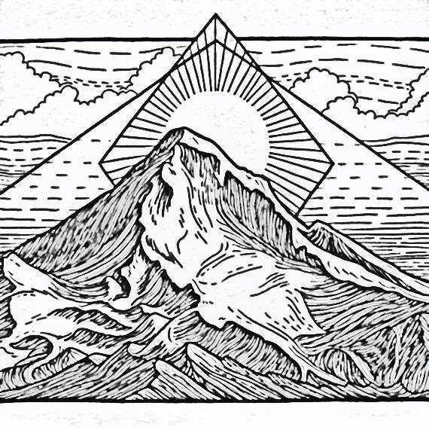
But the stone that struck the statue became a great mountain and filled the whole earth.
Daniel 2:35 NASB

Slide 11
³⁶ "This was the dream; now we shall tell its interpretation before the king.
Daniel 2:36 NASB

Slide 12
Daniel 2:37-38 ³⁷ "You, O king, are the king of kings, to whom the God of heaven has given the kingdom, the power, the strength, and the glory; ³⁸ and wherever the sons of men dwell, or the beasts of the field, or the birds of the sky, He has given them into your hand and has caused you to rule over them all. You are the head of gold.

Slide 13
Daniel 2:39 ³⁹ "And after you there will arise another kingdom inferior to you,
then another third kingdom of bronze, which will rule over all the earth.

Slide 14
Daniel 2:40 ⁴⁰ "Then there will be a fourth kingdom as strong as iron; inasmuch as iron crushes and shatters all things, so, like iron that breaks in pieces, it will crush and break all these in pieces.

Slide 15
Daniel 2:41-43 "And in that you saw the feet and toes, partly of potter's clay and partly of iron, it will be a divided kingdom; but it will have in it the toughness of iron, inasmuch as you saw the iron mixed with common clay. ⁴² "And as the toes of the feet were partly of iron and partly of pottery, so some of the kingdom will be strong and part of it will be brittle. ⁴³ "And in that you saw the iron mixed with common clay, they will combine with one another in the seed of men; but they will not adhere to one another, even as iron does not combine with pottery.

Slide 16
Observations
GOLD
From top to bottom
Gold is Babylonian empire vs 39
Historical reality, identified in text
Therefore our reference for interpretation
Chronological vs 39, 44
Succession of Kingdoms vs 39
From precious to inferior vs 39
Broad sweep, not detailed (whole passage)
SILVER
BRONZE
IRON
CLAY & IRON

Slide 17
GOLD
1st Kingdom
Babylon 605 – 539 BC (605 battle of Carchemish)
SILVER
2nd Kingdom
Medo-Persian (Achaemenid Empire) 550 –330 BC (539 Cyrus takes Babylon)
BRONZE
3rd Kingdom
Greek empires– 333 – (63-30) BC
IRON
4th Kingdom, Part A
Roman –753BC– transition to current (last Byzantine outpost -1453 AD)
CLAY & IRON 4th Kingdom, Part B
Roman Final form – current
(Toes still future)

Slide 18
GOLD
Daniel 7:1-4
SILVER
Daniel 7:5; 8:1-12; 11:1-4
BRONZE
Daniel 7:6; 8:1-7; 11:2,5-35
IRON
Daniel 7:7-8
CLAY & IRON
Daniel 7:7-8; 11: 36-45; Rev 13: 1-8; 17:3,7,12-18

Slide 19
Daniel 2:44-45 NASB
⁴⁴ "And in the days of those kings the God of heaven will set up a kingdom which will never be destroyed, and that kingdom will not be left for another people; it will crush and put an end to all these kingdoms, but it will itself endure forever. ⁴⁵ "Inasmuch as you saw that a stone was cut out of the mountain without hands and that it crushed the iron, the bronze, the clay, the silver, and the gold, the great God has made known to the king what will take place in the future; so the dream is
true, and its interpretation is trustworthy."

Slide 20
Daniel Is Here
A Map of the Kingdoms to Come

Slide 21
A Map of the Kingdoms to Come
You are Here!

Slide 22
Daniel 2:46-49 Then King Nebuchadnezzar fell on his face and did homage to Daniel, and gave orders to present to him an offering and fragrant incense. ⁴⁷ The king answered Daniel and said, "Surely your God is a God of gods and a Lord of kings and a revealer of mysteries, since you have been able to reveal this mystery." ⁴⁸ Then the king promoted Daniel and gave him many great gifts, and he made him ruler over the whole province of Babylon and chief prefect over all the wise men of Babylon. ⁴⁹ And Daniel made request of the king, and he appointed Shadrach, Meshach and Abed-nego over the administration of the province of Babylon, while Daniel was at the king's court.

