Slide 1
Trusting
the Most High God
in perilous times
The king is humbled by god
Daniel 4:28-37

Slide 2
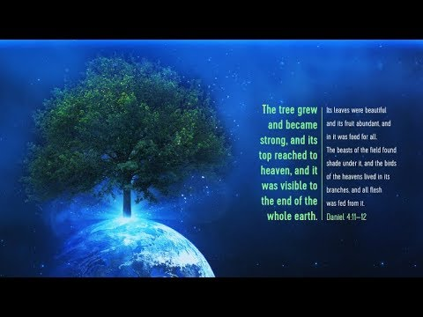
Faithlife.com

Slide 3
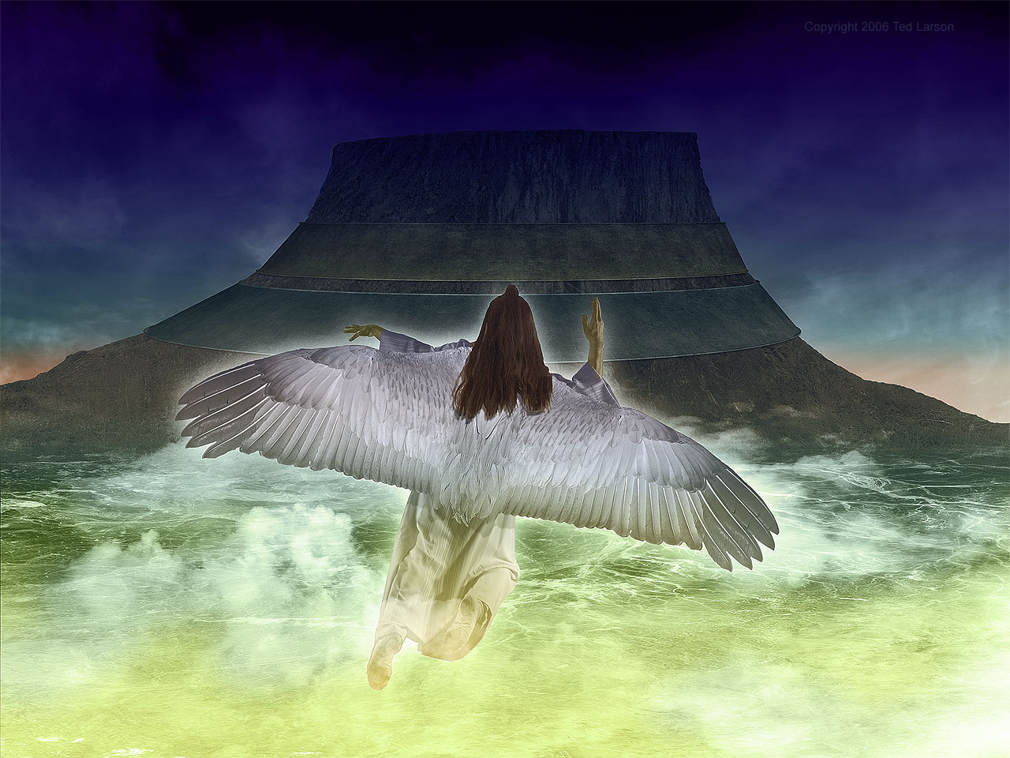
loudcryofthethirdangel.com

Slide 4
“Therefore O king, may my advice be pleasing to you: break away now from your sins by doing righteousness and from your iniquities by showing mercy to the poor, in case there may be a prolonging of your prosperity.” Dan. 4:27

Slide 5
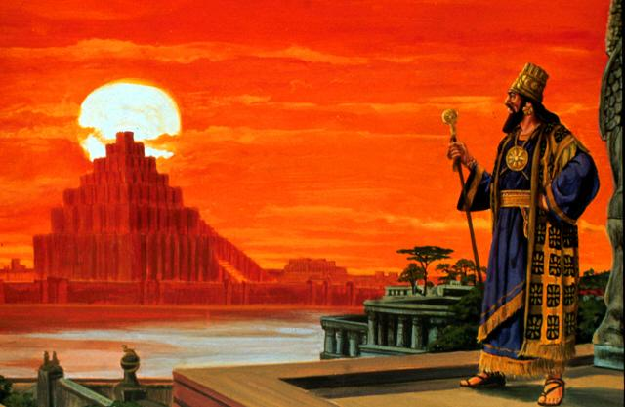
4:30 “The king reflected and said, ‘Is this not Babylon the great, which I myself have built as a royal residence by the might of my power and for the glory of my majesty?’”
the2520.com

Slide 6
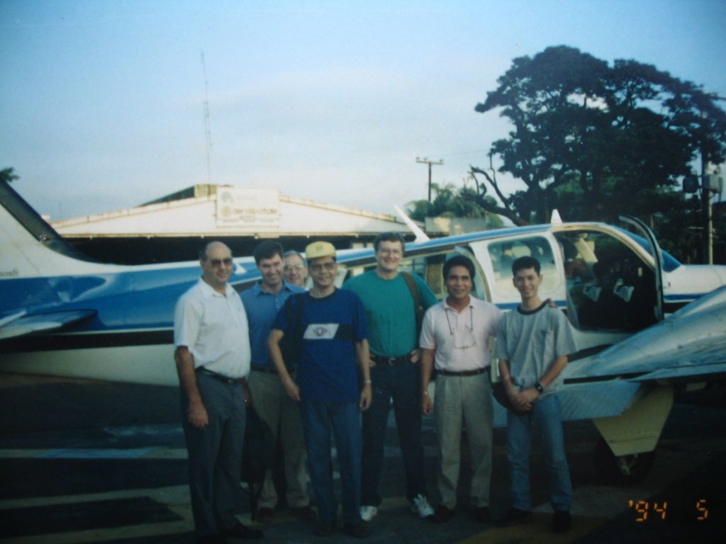

Slide 7
Deut 8:11-14, 17,18 "Beware lest you forget the Lord your God by not keeping His commandments and His ordinances and His statutes which I am commanding you today; lest, when you have eaten and are satisfied, and have built good houses and lived in them, and when your herds and your flocks multiply, and your silver and gold multiply, and all that you have multiplies, then your heart becomes proud, and you forget the Lord your God who brought you out from the land of Egypt, out of the house of slavery… "Otherwise, you may say in your heart, 'My power and the strength of my hand made me this wealth.' "But you shall remember the Lord your God, for it is He who is giving you power to make wealth, that He may confirm His covenant which He swore to your fathers, as it is this day.”

Slide 8
Dan. 4:31,32 "While the word was in the king's mouth, a voice came from heaven, saying, 'King Nebuchadnezzar, to you it is declared: sovereignty has been removed from you, and you will be driven away from mankind, and your dwelling place will be with the beasts of the field. You will be given grass to eat like cattle, and seven periods of time will pass over you until you recognize that the Most High is ruler over the realm of mankind and bestows it on whomever He wishes.'

Slide 9
- Isaiah 2:11,12 “The proud look of man will be abased, and the loftiness of man will be humbled, And the Lord alone will be exalted in that day. For the LORD of hosts will have a day of reckoning against everyone who is proud and lofty, And against everyone who is lifted up, That he may be abased.”

Slide 10
- Isaiah 2:11,12 “The proud look of man will be abased, and the loftiness of man will be humbled, And the Lord alone will be exalted in that day. For the LORD of hosts will have a day of reckoning against everyone who is proud and lofty, And against everyone who is lifted up, That he may be abased.”
- Proverbs 29:23 “A man's pride will bring him low, But a humble spirit will obtain honor.”

Slide 11
- Isaiah 2:11,12 “The proud look of man will be abased, and the loftiness of man will be humbled, And the Lord alone will be exalted in that day. For the LORD of hosts will have a day of reckoning against everyone who is proud and lofty, And against everyone who is lifted up, That he may be abased.”
- Proverbs 29:23 “A man's pride will bring him low, But a humble spirit will obtain honor.”
- Mat 23:12 “And whoever exalts himself shall be humbled; and whoever humbles himself shall be exalted.”

Slide 12
- Isaiah 2:11,12 “The proud look of man will be abased, and the loftiness of man will be humbled, And the Lord alone will be exalted in that day. For the LORD of hosts will have a day of reckoning against everyone who is proud and lofty, And against everyone who is lifted up, That he may be abased.”
- Proverbs 29:23 “A man's pride will bring him low, But a humble spirit will obtain honor.”
- Mat 23:12 “And whoever exalts himself shall be humbled; and whoever humbles himself shall be exalted.”
- James 4:6: “…God is opposed to the proud, but gives grace to the humble.”

Slide 13
- Isaiah 2:11,12 “The proud look of man will be abased, and the loftiness of man will be humbled, And the Lord alone will be exalted in that day. For the LORD of hosts will have a day of reckoning against everyone who is proud and lofty, And against everyone who is lifted up, That he may be abased.”
- Proverbs 29:23 “A man's pride will bring him low, But a humble spirit will obtain honor.”
- Mat 23:12 “And whoever exalts himself shall be humbled; and whoever humbles himself shall be exalted.”
James 4:6: “…God is opposed to the proud, but gives grace to the humble.”
Proverbs 16:18 “Pride goes before destruction, And a haughty spirit before a fall.”

Slide 14

21stcenturychristianity.com

Slide 15

21stcenturychristianity.com

Slide 16
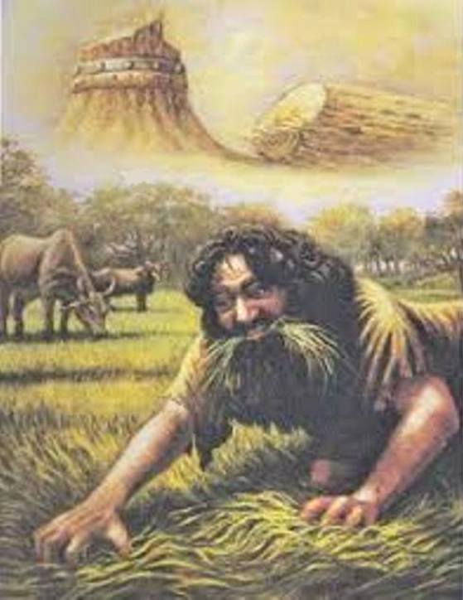
Dan. 4:33 “Immediately the word concerning Nebuchadnezzar was fulfilled; and he was driven away from mankind and began eating grass like cattle, and his body was drenched with the dew of heaven until his hair had grown like eagles' feathers and his nails like birds' claws.”
understandingdaniel.com

Slide 17
4:34 “But at the end of that period, I, Nebuchadnezzar, raised my eyes toward heaven and my reason returned to me, and I blessed the Most High and praised and honored Him who lives forever; For His dominion is an everlasting dominion, And His kingdom endures from generation to generation.
4:35 All the inhabitants of the earth are accounted as nothing, But He does according to His will in the host of heaven and among the inhabitants of earth; And no one can ward off His hand Or say to Him, ‘What have You done?’”

Slide 18
36 “At that time my reason returned to me. And my majesty and splendor were restored to me for the glory of my kingdom, and my counselors and my nobles began seeking me out; so I was reestablished in my sovereignty, and surpassing greatness was added to me.”

Slide 19
36 “At that time my reason returned to me. And my majesty and splendor were restored to me for the glory of my kingdom, and my counselors and my nobles began seeking me out; so I was reestablished in my sovereignty, and surpassing greatness was added to me.
37 Now I, Nebuchadnezzar, praise, exalt and honor the King of heaven, for all His works are true and His ways just, and He is able to humble those who walk in pride.”

Slide 20
Jeremiah 9:23, 24 “Thus says the Lord, "Let not a wise man boast of his wisdom, and let not the mighty man boast of his might, let not a rich man boast of his riches; but let him who boasts boast of this, that he understands and knows Me, that I am the Lord who exercises lovingkindness, justice, and righteousness on earth; for I delight in these things," declares the Lord.”

Slide 21
1 Peter 5:5b-6 “… all of you, clothe yourselves with humility toward one another, for God is opposed to the proud, but gives grace to the humble. Humble yourselves, therefore, under the mighty hand of God, that He may exalt you at the proper time”

Slide 22
Philippians 2: 3-11
“Do nothing from selfishness or empty conceit, but with humility of mind let each of you regard one another as more important than himself; do not merely look out for your own personal interests, but also for the interests of others. Have this attitude in yourselves which was also in Christ Jesus, who, although He existed in the form of God, did not regard equality with God a thing to be grasped, but emptied Himself, taking the form of a bond-servant, and being made in the likeness of men. And being found in appearance as a man, He humbled Himself by becoming obedient to the point of death, even death on a cross. Therefore also God highly exalted Him, and bestowed on Him the name which is above every name, that at the name of Jesus every knee should bow, of those who are in heaven, and on earth, and under the earth, and that every tongue should confess that Jesus Christ is Lord, to the glory of God the Father.”

Slide 23
Psalm 34:18 “The Lord is near to the brokenhearted, And saves those who are crushed in spirit.”

Slide 24
Psalm 34:18 “The Lord is near to the brokenhearted, And saves those who are crushed in spirit.”
Isaiah 57:15 “For thus says the high and exalted One Who lives forever, whose name is Holy, "I dwell on a high and holy place, And also with the contrite and lowly of spirit In order to revive the spirit of the lowly And to revive the heart of the contrite.”

Slide 25
Psalm 34:18 “The Lord is near to the brokenhearted, And saves those who are crushed in spirit.”
Isaiah 57:15 “For thus says the high and exalted One Who lives forever, whose name is Holy, "I dwell on a high and holy place, And also with the contrite and lowly of spirit In order to revive the spirit of the lowly And to revive the heart of the contrite.”
Isaiah 66:2b "But to this one I will look, To him who is humble and contrite of spirit, and who trembles at My word.”

Slide 26
Psalm 34:18 “The Lord is near to the brokenhearted, And saves those who are crushed in spirit.”
Isaiah 57:15 “For thus says the high and exalted One Who lives forever, whose name is Holy, "I dwell on a high and holy place, And also with the contrite and lowly of spirit In order to revive the spirit of the lowly And to revive the heart of the contrite.”
Isaiah 66:2b "But to this one I will look, To him who is humble and contrite of spirit, and who trembles at My word.”
Micah 6:8 He has told you, O man, what is good; And what does the Lord require of you But to do justice, to love kindness, And to walk humbly with your God?

