Slide 1
Trusting
The Most High God
In Perilous Times
Daniel 5:1-16
Seeing the Hand of God

Slide 2
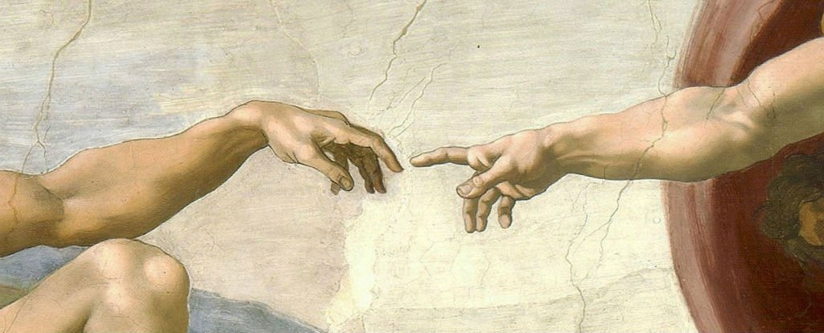

Slide 3
The Hand of God
The hands of a savior …
Psalm 22:16 “They have pierced my hands”
John 20:25 John 20:25 ²⁵ So the other disciples were saying to him, "We have seen the Lord!" But he said to them, "Unless I see in His hands the imprint of the nails, and put my finger into the place of the nails, and put my hand into His side, I will not believe."

Slide 4
The Hand of God
Or the hands of a judge…
Joshua 5:13 “A man was standing opposite of him with his sword drawn in his hand”
Lord!" But he said to them, "Unless I see in His hands the imprint of the nails, and put my finger into the place of the nails, and put my hand into His side, I will not believe."

Slide 5
Daniel 5:1-16
King Belshazzar gave a great banquet for a thousand of his nobles, with whom he drank. Under the influence of the wine, he ordered the gold and silver vessels which Nebuchadnezzar, his father, had taken from the temple in Jerusalem, to be brought in so that the king, his nobles, his consorts, and his concubines might drink from them. When the gold vessels taken from the temple, the house of God in Jerusalem, had been brought in, and while the king, his nobles, his consorts, and his concubines were drinking wine from them, they praised their gods of gold and silver, bronze and iron, wood and stone. 5:1-4

Slide 6
A Brief History of Belshazzar
23 years after Nebuchadnezzar's death
Nebuchadnezzar’s son reigned 2 years → murdered
Nebuchadnezzar’s son in law reigned 4 years
Nebuchadnezzar’s grandson reigns 9 months → murdered
Reign passes to the Nabonidus, who reigns for 17 years… but
Nabonidus left the capital at least 10 years earlier on a mission to restore the temples of Sin, the moon god
Belshazzar has led for at least a decade as crown prince and regent of all of Babylon

Slide 7
Suddenly, opposite the lampstand, the fingers of a human hand appeared, writing on the plaster of the wall in the king’s palace. When the king saw the hand that wrote, his face became pale; his thoughts terrified him, his hip joints shook, and his knees knocked. The king shouted for the enchanters, Chaldeans, and diviners to be brought in. “Whoever reads this writing and tells me what it means,” he said to the wise men of Babylon, “shall be clothed in purple, wear a chain of gold around his neck, and be third in governing the kingdom.” But though all the king’s wise men came in, none of them could either read the writing or tell the king what it meant. Then King Belshazzar was greatly terrified; his face became pale, and his nobles were thrown into confusion. 5: 5-9

Slide 8
The knowledge of God
Knowledge of God through supernatural experience is not superior to knowledge of God found through the scripture.
Luke 16:29-31
But Abraham *said, ‘They have Moses and the Prophets; let them hear them.’ But he said, ‘No, father Abraham, but if someone goes to them from the dead, they will repent!’ But he said to him, ‘If they do not listen to Moses and the Prophets, they will not be persuaded even if someone rises from the dead.’
Whether it is supernatural or scriptural in origin we will respond the same way to divine revelation.

Slide 9
Belshazzar and God
He knew who Nebuchadnezzar was.
He knew his story (as seen in vs. 18-22).
He knew that the God of heaven was real.
He consciously chose to rebel against and shame the God that Nebuchadnezzar had come to honor and worship(v23).

Slide 10
The Hand of Judgment
“Be not deceived; God is not mocked: for whatsoever a man soweth, that shall he also reap.”
Galatians 6:7

Slide 11
The Hand of Judgment
In the Bible mockery is a behavior and attitude shown by the fool (Psalm 74:22), the wicked (Psalm 1:1), the enemy (Psalm 74:10), the hater of knowledge (Proverbs 1:22; 13:1), the proud (Psalm 119:51; Isaiah 37:17), and the unteachable (Proverbs 15:12). A mocker goes beyond mere lack of judgment to making a conscious decision for evil. Mockers are without a spirit of obedience, teachability, discernment, wisdom, worship, or faith. –gotquestions.org
Belshazzar is judged based on his knowledge and heart motivation, not his ignorance (vs. 22 and 23).

Slide 12
When the queen heard of the discussion between the king and his nobles, she entered the banquet hall and said, “O king, live forever! Do not let your thoughts terrify you, or your face become so pale! There is a man in your kingdom in whom is a spirit of the holy gods; during the lifetime of your father he showed brilliant insight and god-like wisdom. King Nebuchadnezzar, your father, made him chief of the magicians, enchanters, Chaldeans, and diviners. Because this Daniel, whom the king named Belteshazzar, has shown an extraordinary spirit, knowledge, and insight in interpreting dreams, explaining riddles and solving problems, let him now be summoned to tell you what this means.” 5:10-12

Slide 13
Daniels Faith
Daniels faith has stood as a testimony to the court for 66 years.
He is immediately thought of by the queen (or queen mother).
He is remembered as a man of God, as the queen’s description of him points out multiple times.
This righteousness that stood him above the others was a result of his faith, not the cause of it (as seen through chapters 1-2).

Slide 14
Then Daniel was brought into the presence of the king. The king asked him, “Are you the Daniel, one of the Jewish exiles, whom my father, the king, brought from Judah? I have heard that the spirit of the gods is in you, that you have shown brilliant insight and extraordinary wisdom. The wise men and enchanters were brought in to me to read this writing and tell me its meaning, but they could not say what the words meant. But I have heard that you can give interpretations and solve problems; now, if you are able to read the writing and tell me what it means, you shall be clothed in purple, wear a chain of gold around your neck, and be third in governing the kingdom.” 5:13-16

Slide 15
Choose this day who you will serve…
Daniel is offered the wealth, power and prestige in the kingdom of Babylon- the head of gold.
His choice now parallels his choice in chapter 1 when offered all the finest that the court had to offer a servant of the king. This time however, he would be ruler.
Choose to rule in the kingdom of gold today, or serve in the everlasting kingdom of the “far” future.

Slide 16
Challenge
Are you ready to hear Gods divine revelation to you no matter its form? Or are you waiting for a “sign”?
God’s judgments are just, based on the heart and not only the outward actions (1 Samuel 16:7).
Is your association with God strong enough that after a quarter of a century of being out of the public eye you would still be thought of in times of need as a representative of God?
When you are faced with the choice of todays kingdom or tomorrows where do you lean and how do you choose?

