Slide 1
Trusting
the Most High God
in perilous times
Daniel, Part 2 [Ch 7-12]
Intro to Biblical Prophecy

Slide 4
Simplified Outline
The History Of Daniel (Chapters 1-6) (15 messages)
Entering The Kings Service (Ch 1)
The Dream Of The Great Statue (ch2)
Nebuchadnezzar’s Image Of Gold (ch3)
Nebuchadnezzar’s Vision Of A Great Tree (ch4)
Belshazzar And The Writing On The Wall (ch5)
Darius’s Foolish Decree (ch6)
The Prophecies of Daniel (Chapters 7-12)
Four Beasts (ch7)
Vision of Ram and Goat (ch8)
Vision of Seventy Weeks (ch9)
Vision of Israel's Future (ch10-12)

Slide 5
What is Biblical Prophecy?
A foretelling; prediction; a declaration of something to come. As God only knows future events with certainty, no being but God or some person informed by God, can utter a real prophecy.

Slide 6
Prophecy plays a dominant role in the word of God
Isaiah 46:9 "Remember the former things long past, For I am God, and there is no other; I am God, and there is no one like Me,
10 Declaring the end from the beginning, And from ancient times things which have not been done, Saying, 'My purpose will be established, And I will accomplish all My good pleasure';"

Slide 7
Half of the prophecies in the Bible have already been fulfilled in a literal way

Slide 8
The Purposes of Biblical Prophecy
Biblical prophecy reveals God’s desire to communicate His plans
Hebrews 1:1 God, after He spoke long ago to the fathers in the prophets in many portions and in many ways,
2 in these last days has spoken to us in His Son, whom He appointed heir of all things, through whom also He made the world."
Various forms of literary styles
Visions
Dreams
Symbols

Slide 9
The Purposes of Biblical Prophecy
Biblical prophecy reveals God’s desire to communicate His plans
Biblical prophecy declares the glory and the purposes of God in salvation
Genesis 3:15 “And I will put enmity Between you and the woman, And between your seed and her seed; He shall bruise you on the head, And you shall bruise him on the heel.”

Slide 10
 | Prediction | Prophecy | Fulfillment
1 | The Messiah will be born in Bethlehem | Micah 5:2 | Matt 2:1-6
2 | The Messiah will be born of a virgin | Isaiah 7:14 | Matt 1:20-23
3 | The Messiah will be a prophet like Moses | Deut 18:15 | John 7:40-42 Acts 3:20-23
4 | The Messiah will enter Jerusalem on a donkey’s colt | Zech 9:9 | Luke 19:35-37
5 | The Messiah will be rejected by His own people | Isa 53:1, 3 | John 12:37-38
6 | The Messiah will be betrayed by one of his followers | Ps 41:9, 55:12-13 | Matthew 26:47, 49-50a
7 | Will be betrayed for 30 pieces of silver | Zech 11:12-13 | Matt 26:14-16

Slide 12
Mathematical Probability
The probability of all 8 prophecies being fulfilled accidently in the life of one person…. 1x10¹⁷ [One in one hundred quadrillion]
The probability of one person fulfilling 48 prophecies…. 1x10¹⁵⁷
The probability of one person fulfilling all 300 prophecies….
Jesus
Prof. Peter Stoner
http://christinprophecy.org/articles/applying-the-science-of-probability-to-the-scriptures/

Slide 13
The Purposes of Biblical Prophecy
Biblical prophecy reveals God’s desire to communicate
Biblical prophecy declares the glory and the purposes of God in His salvation
Biblical prophecy reveals God’s plan for the nation of Israel

Slide 14
Gen 15:13 God said to Abram, "Know for certain that your descendants will be strangers in a land that is not theirs, where they will be enslaved and oppressed four hundred years."
Ex 12:40 Now the time that the sons of Israel lived in Egypt was four hundred and thirty years."
Jeremiah 25:11 “This whole land will be a desolation and a horror, and these nations will serve the king of Babylon seventy years.”
Nebuchadnezzar besieges Jerusalem
First return under Zerubbabel
Decree of
Cyrus
605 B.C.
70 Years
538 B.C.
536 B.C.
Isaiah 44:28 “It is I who says of Cyrus, 'He is My shepherd! And he will perform all My desire.' And he declares of Jerusalem, 'She will be built,' And of the temple, 'Your foundation will be laid.”
Isaiah 45:1 Thus says the LORD to Cyrus His anointed, Whom I have taken by the right hand, To subdue nations before him And to loose the loins of kings; To open doors before him so that gates will not be shut:"

Slide 16
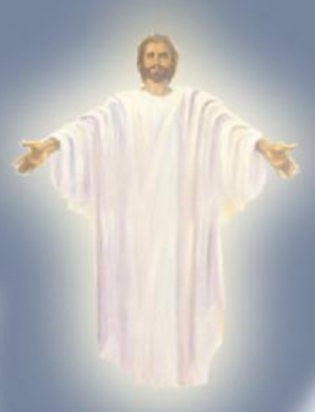
The 70x weeks of Daniel, Ch 9
Church Age
49 years
434 years
7 years
﹏﹏﹏
445 BC
30 AD
Tribulation
Millennium
396 BC
Decree of
Artaxerxes I
Messiah
cut off
To finish the transgression
To make an end of sin
To make atonement for iniquity
To bring everlasting righteousness
To seal up vision and prophecy
To anoint the most holy place
Daniel 9:25 "So you are to know and discern that from the issuing of a decree to restore and rebuild Jerusalem until Messiah the Prince there will be seven weeks and sixty-two weeks; it will be built again, with plaza and moat, even in times of distress.
26 "Then after the sixty-two weeks the Messiah will be cut off and have nothing, and the people of the prince who is to come will destroy the city and the sanctuary"

Slide 17
The Purposes of Biblical Prophecy
Biblical prophecy reveals God’s desire to communicate
Biblical prophecy declares the glory and the purposes of God in His salvation
Biblical prophecy reveals God’s plan for the nation of Israel
Biblical prophecy reveals God’s heart towards sin and judgment

Slide 18
“Times of the Gentiles”
Babylonian
Captivity
Second Advent of Christ
Church Age
Times of the Gentiles
“Jerusalem Trampled”
Millennium
Tribulation
Messiah cut off
Rapture
End of the gentile subjection
Partly adapted from JW de Silva’s OIBP, p78

Slide 19
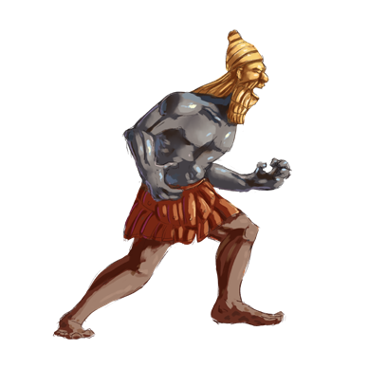
Chapter 2

Slide 20
Chapter 7

Slide 21
Chapter 8

Slide 22
Prophecies yet to be fulfilled
Christ’s
2nd coming
The eternal bliss with God
Rapture of the Church
The Great white throne judgment
Millennial reign
Tribulation
Judgment
seat of Christ
Satan in the bottomless pit
Marriage supper of the Lamb
Battle of Armageddon
Resurrection of the OT saints
Judgment of the living nations
Satan released from the bottomless pit
The battle of Gog and Magog
The eternal damnation of unbelievers without God

Slide 23
Revelation 1:3 “Blessed is he who reads and those who hear the words of the prophecy, and heed the things which are written in it; for the time is near.”

