Slide 1
1 Corinthians
Conclusion

Slide 2
1 Corinthians 16
19 The churches of Asia greet you. Aquila and Prisca greet you heartily in the Lord, with the church that is in their house. 20 All the brethren greet you. Greet one another with a holy kiss.
21 The greeting is in my own hand—Paul. 22 If anyone does not love the Lord, he is to be accursed. Maranatha. 23 The grace of the Lord Jesus be with you. 24 My love be with you all in Christ Jesus. Amen.

Slide 3
Be on the alert, stand firm in the faith, act like men, be strong. Let all that you do be done in love.
1 Corinthians 16:13,14

Slide 4
Be Alert

Slide 5
Questions to consider…
Why are Christians divided?
Do we struggle with that issue here?
How do I experience God’s power in my life?
What should the church do when a Christian refuses to repent of sin?
Is it really our place to judge?
Why is sexual immorality different than other sins?

Slide 6
Questions to consider…
What if your husband or wife leaves you?
As a Christian, what am I free to do, and what am I not free to do?
What is the role of women in public ministry?
Why can’t they talk at the Lord’s Supper?
In fact, why do we do the Lord’s Supper the way we do here?
What kind of bodies will we have in heaven?

Slide 7
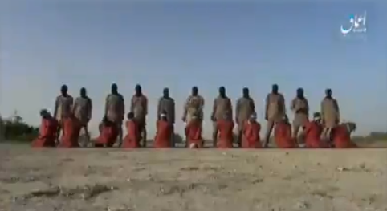
Day after Christmas – 11 killed in Nigeria

Slide 8
Stand Firm

Slide 9
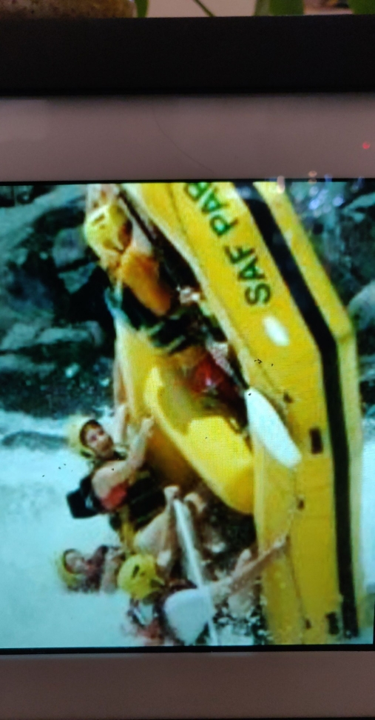

Slide 10
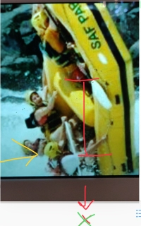

Slide 11
The Gospel in which You Stand
Now I make known to you, brethren, the gospel which I preached to you, which also you received, in which also you stand, 2 by which also you are saved, if you hold fast the word which I preached to you, unless you believed in vain.
3 For I delivered to you as of first importance what I also received, that Christ died for our sins according to the Scriptures, 4 and that He was buried, and that He was raised on the third day according to the Scriptures, 1 Cor. 15:1-4

Slide 12
The Gospel in which You Stand
Now I make known to you, brethren, the gospel which I preached to you, which also you received, in which also you stand, 2 by which also you are saved, if you hold fast the word which I preached to you, unless you believed in vain.
3 For I delivered to you as of first importance what I also received, that Christ died for our sins according to the Scriptures, 4 and that He was buried, and that He was raised on the third day according to the Scriptures, 1 Cor. 15:1-4

Slide 13
The Gospel in which You Stand
Now I make known to you, brethren, the gospel which I preached to you, which also you received, in which also you stand, 2 by which also you are saved, if you hold fast the word which I preached to you, unless you believed in vain.
3 For I delivered to you as of first importance what I also received, that Christ died for our sins according to the Scriptures, 4 and that He was buried, and that He was raised on the third day according to the Scriptures, 1 Cor. 15:1-4

Slide 14
The Gospel in which You Stand
Now I make known to you, brethren, the gospel which I preached to you, which also you received, in which also you stand, 2 by which also you are saved, if you hold fast the word which I preached to you, unless you believed in vain.
3 For I delivered to you as of first importance what I also received, that Christ died for our sins according to the Scriptures, 4 and that He was buried, and that He was raised on the third day according to the Scriptures, 1 Cor. 15:1-4

Slide 15
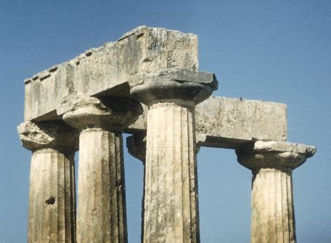
1 Corinthians
M I N D
Of Christ
Notes:
We came up with this “corny” acronym, MIND, to help us remember.
As you see in 2:16, Paul says, “…But we have the mind of Christ.”
That concept will be displayed on our banner page for our PowerPoint presentations as a further memory tool.
“Many Individuals; No Divisions”
As we look at the outline of the book in just a second, you will see that Paul talks about individuals in the church, and how we should live.
He talks about individual spiritual gifts, and how we should use them in the context of the church body.
He talks about individuals worshiping God, and again, how that is to be done in the context of the group meeting.
Individual believers are very important to Paul.
BUT, almost 25% of this letter is devoted to the topic of divisions. Apparently that was a problem at the church in Corinth, as I believe it is today. And Paul addresses it from several different angles. But the message is the same: Yes, you are individual members of the body, but the MIND of Christ is that there be NO DIVISIONS among us; that we be united in Christ.
And so that’s why we want you to remember MIND; Many Individuals; No Divisions.

Slide 16
One Mind
Now we have received, not the spirit of the world, but the Spirit who is from God, so that we may know the things freely given to us by God, 1 Cor 2:12
For WHO HAS KNOWN THE MIND OF THE LORD, THAT HE WILL INSTRUCT HIM? But we have the mind of Christ.
1 Cor 2:16
¶Now I exhort you, brethren, by the name of our Lord Jesus Christ, that you all agree and that there be no divisions among you, but that you be made complete in the same mind and in the same judgment.
1 Cor 1:10

Slide 17
1 Corinthians
I. The wisdom of God is to have the mind of Christ and allow no divisions in the body (Ch.1-4)
II. Maintain purity in the body by judging sin in your midst (Ch. 5-6)
III. Instructions on matters of interest to the church (Ch. 7-10)
IV. Instructions for the orderly meetings of the church (Ch. 11-14)
V. Instruction on the resurrection (Ch. 15)
VI. Instructions on giving, and final exhortations (Ch. 16)

Slide 18
1 Corinthians
THEME:
“Living together as individuals in one body by having the mind of Christ”
1 Corinthians 1:10, 2:16

Slide 19
Be Strong

Slide 20
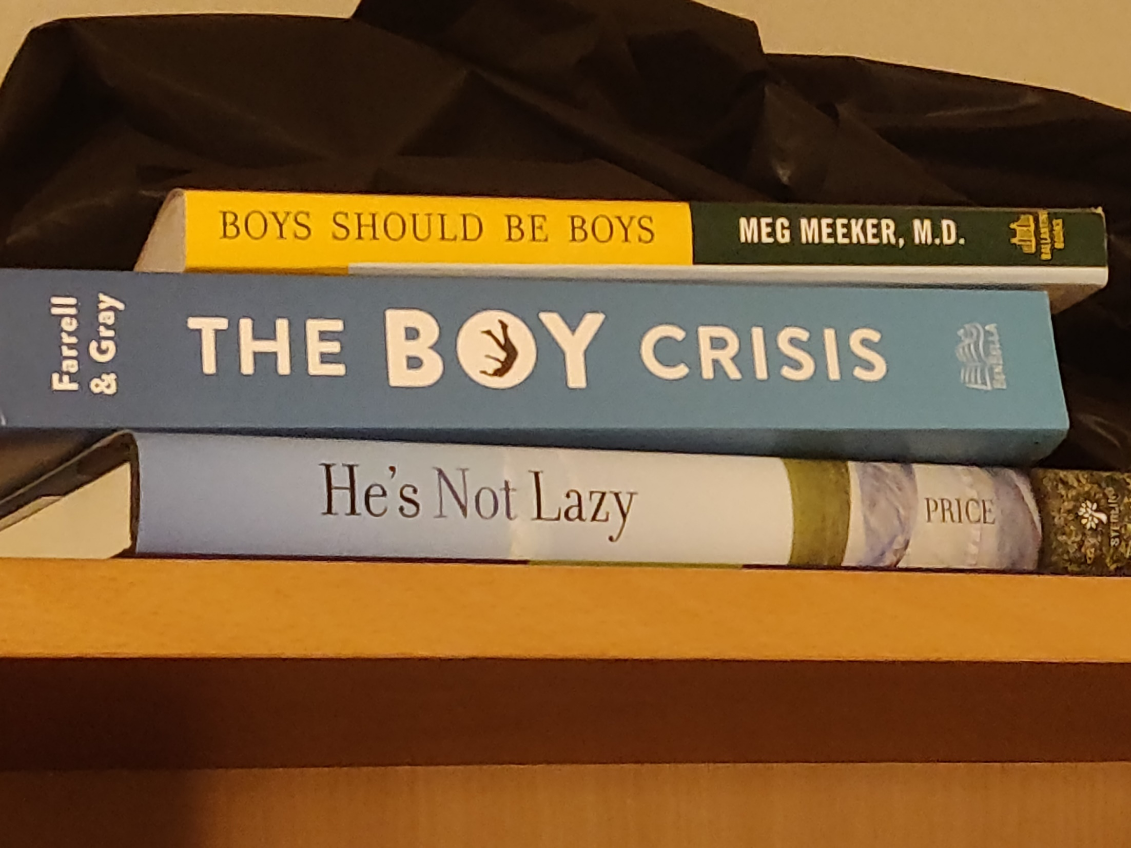

Slide 21
“Remember the word that I said to you, ‘A slave is not greater than his master.’ If they persecuted Me, they will also persecute you; if they kept My word, they will keep yours also.
Jn 15:20

Slide 22
Do All in Love

Slide 23
Now concerning things sacrificed to idols, we know that we all have knowledge. Knowledge makes arrogant, but love edifies.
1Co 8:1

Slide 24
Make It So

