Slide 2
Christ fulfilled the requirements of the law
Matt. 5:17 “Do not think that I came to abolish the Law or the Prophets; I did not come to abolish but to fulfill.”

Slide 3
The Holiness of God
Lev. 19:2 “Speak to all the congregation of the sons of Israel and say to them, ‘You shall be holy, for I the LORD your God am holy.’”
Theme verse:
NT Equivalent:
1 Pet 1:15-16

Slide 4
Obedience to God’s commandments
“I am the Lord” – 49 times

Slide 5
Lev. 18:4 ‘You are to perform My judgments and keep My statutes, to live in accord with them; I am the LORD your God.
Lev. 19:3 ‘Every one of you shall reverence his mother and his father, and you shall keep My sabbaths; I am the LORD your God.
Lev. 19:4 ‘Do not turn to idols or make for yourselves molten gods; I am the LORD your God.
Lev. 19:18 ‘You shall not take vengeance, nor bear any grudge against the sons of your people, but you shall love your neighbor as yourself; I am the LORD.
Eph. 6:1 Children, obey your parents in the Lord, for this is right.
James 1:22 But prove yourselves doers of the word, and not merely hearers who delude themselves.
1John 2:4 The one who says, “I have come to know Him,” and does not keep His commandments, is a liar, and the truth is not in him;
1John 2:5 but whoever keeps His word, in him the love of God has truly been perfected. By this we know that we are in Him:
Fear of God
Love of God

Slide 6
The Principles in approaching God

Slide 7
“Sacrifice”
Eph. 5:2 and walk in love, just as Christ also loved you and gave Himself up for us, an offering and a sacrifice to God as a fragrant aroma.
Lev 17:11 ‘For the life of the flesh is in the blood, and I have given it to you on the altar to make atonement for your souls; for it is the blood by reason of the life that makes atonement.’
1Pet. 3:18 For Christ also died for sins once for all, the just for the unjust, so that He might bring us to God, having been put to death in the flesh, but made alive in the spirit;

Slide 8
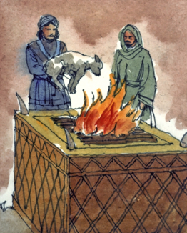
Voluntary
Burnt offering
Grain offering
How Christ fulfilled
Peace offering
Mandatory
How believers should approach God
Sin offering
Guilt offering

Slide 9
GOSPEL
1Cor. 15:1 Now I make known to you, brethren, the gospel which I preached to you, which also you received, in which also you stand,

Slide 10
Rom. 15:4 For whatever was written in earlier times was written for our instruction, so that through perseverance and the encouragement of the Scriptures we might have hope
2Tim. 3:16-17 All Scripture is inspired by God and profitable for teaching, for reproof, for correction, for training in righteousness;
so that the man of God may be adequate, equipped for every good work.

Slide 11
Leviticus is a significant book

Slide 12
Leviticus is a systematic book
Genesis
Exodus
Leviticus
Creation
Man ruined
Christ, our promised Savior
Redemption
Man delivered
Christ, our Passover Lamb
Sanctification
Man cleansed (for worship and service)
Christ, our Offeror (High Priest) and our Offering

Slide 13
Leviticus is a systematic book
Leuitikon (Gr.) meaning, “pertaining to the Levites”
Wayyiqrā (Heb.) meaning, “and He called”
Lev. 1:1 Then the LORD called to Moses and spoke to him from the tent of meeting, saying,

Slide 14
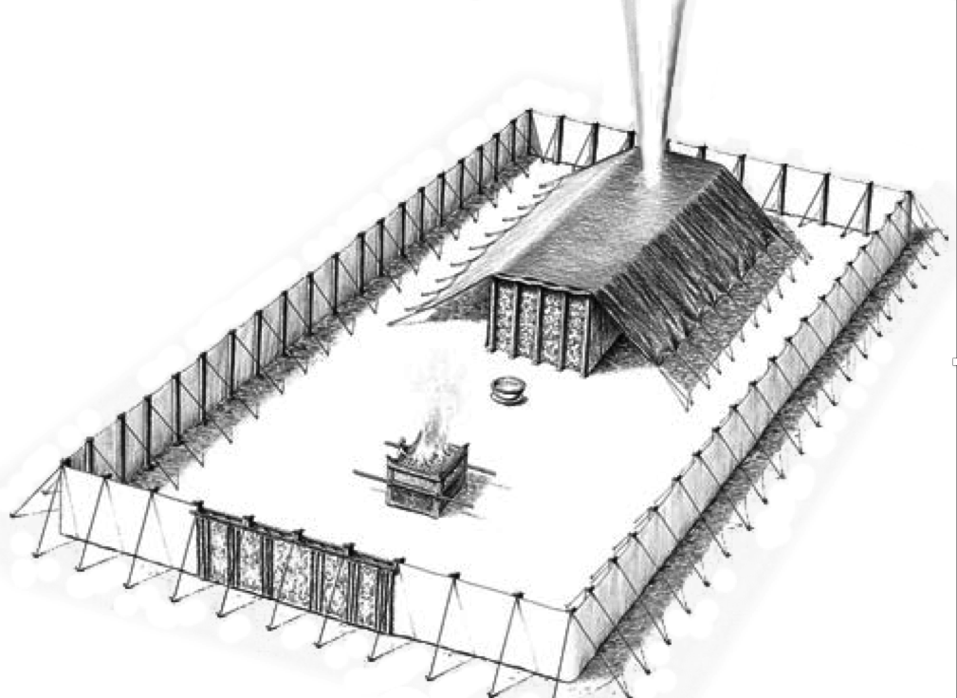
Ex 19
Ex 40, Lev 1:1
Num 1:1

Slide 15
Lev. 1:1 Then the LORD called to Moses and spoke to him from the tent of meeting, saying,
Laws of Sacrifices
Laws of Priesthood
Laws of ceremonial cleansing
Laws of holy living
Laws of feasts
Laws regarding the tabernacle & blasphemy
Laws of sabbath and the year of Jubilee
Laws of blessings and curses
Laws of vows and tithes
The way to approach the holy God (1-16)
The way to walk in holiness (17-27)
Lev 1-27
Num. 1:1 Then the LORD spoke to Moses in the wilderness of Sinai, in the tent of meeting, on the first of the second month, in the second year after they had come out of the land of Egypt, saying,

Slide 16
11 months
Israel at Mt. Sinai
Ten commandments
Erection of the tabernacle (Ex 40:17)
40 years
Beginning of Slavery in Egypt
Israel departs to Sinai (Num 11)
Exodus from Egypt
Israel enters the promised land
~ 430 years
1 year
1875 BC
1444 BC
1406 BC
1446 BC
1445 BC
LEVITICUS
1406 BC
50 days

Slide 17
Leviticus is a sanctifying book
 | Repeated in the NT | Value behind the law still applicable
Category 1 | Yes | Yes
Category 2 | No, because of cultural reasons | Yes
Category 3 | No, because they been set aside by Jesus, or concern rituals which He has fulfilled | Yes
Category 4 | No, because they were particularly related to Israel as a theocratic nation | Yes
p. 58 from Jay Sklar’s book, Leviticus

Slide 18
Rom. 12:1 Therefore I urge you, brethren, by the mercies of God, to present your bodies a living and holy sacrifice, acceptable to God, which is your spiritual service of worship.
1Cor. 6:19, 20 Or do you not know that your body is a temple of the Holy Spirit who is in you, whom you have from God, and that you are not your own?
For you have been bought with a price: therefore glorify God in your body.
1Pet. 1:14, 15 As obedient children, do not be conformed to the former lusts which were yours in your ignorance,
but like the Holy One who called you, be holy yourselves also in all your behavior;

Slide 19
A consistent growth in holy life is impossible without a consistent look at the cross

