Slide 1
The Peace Offering: Celebrating Peace with God
Leviticus 3:1-17; 7:11-34

Slide 2
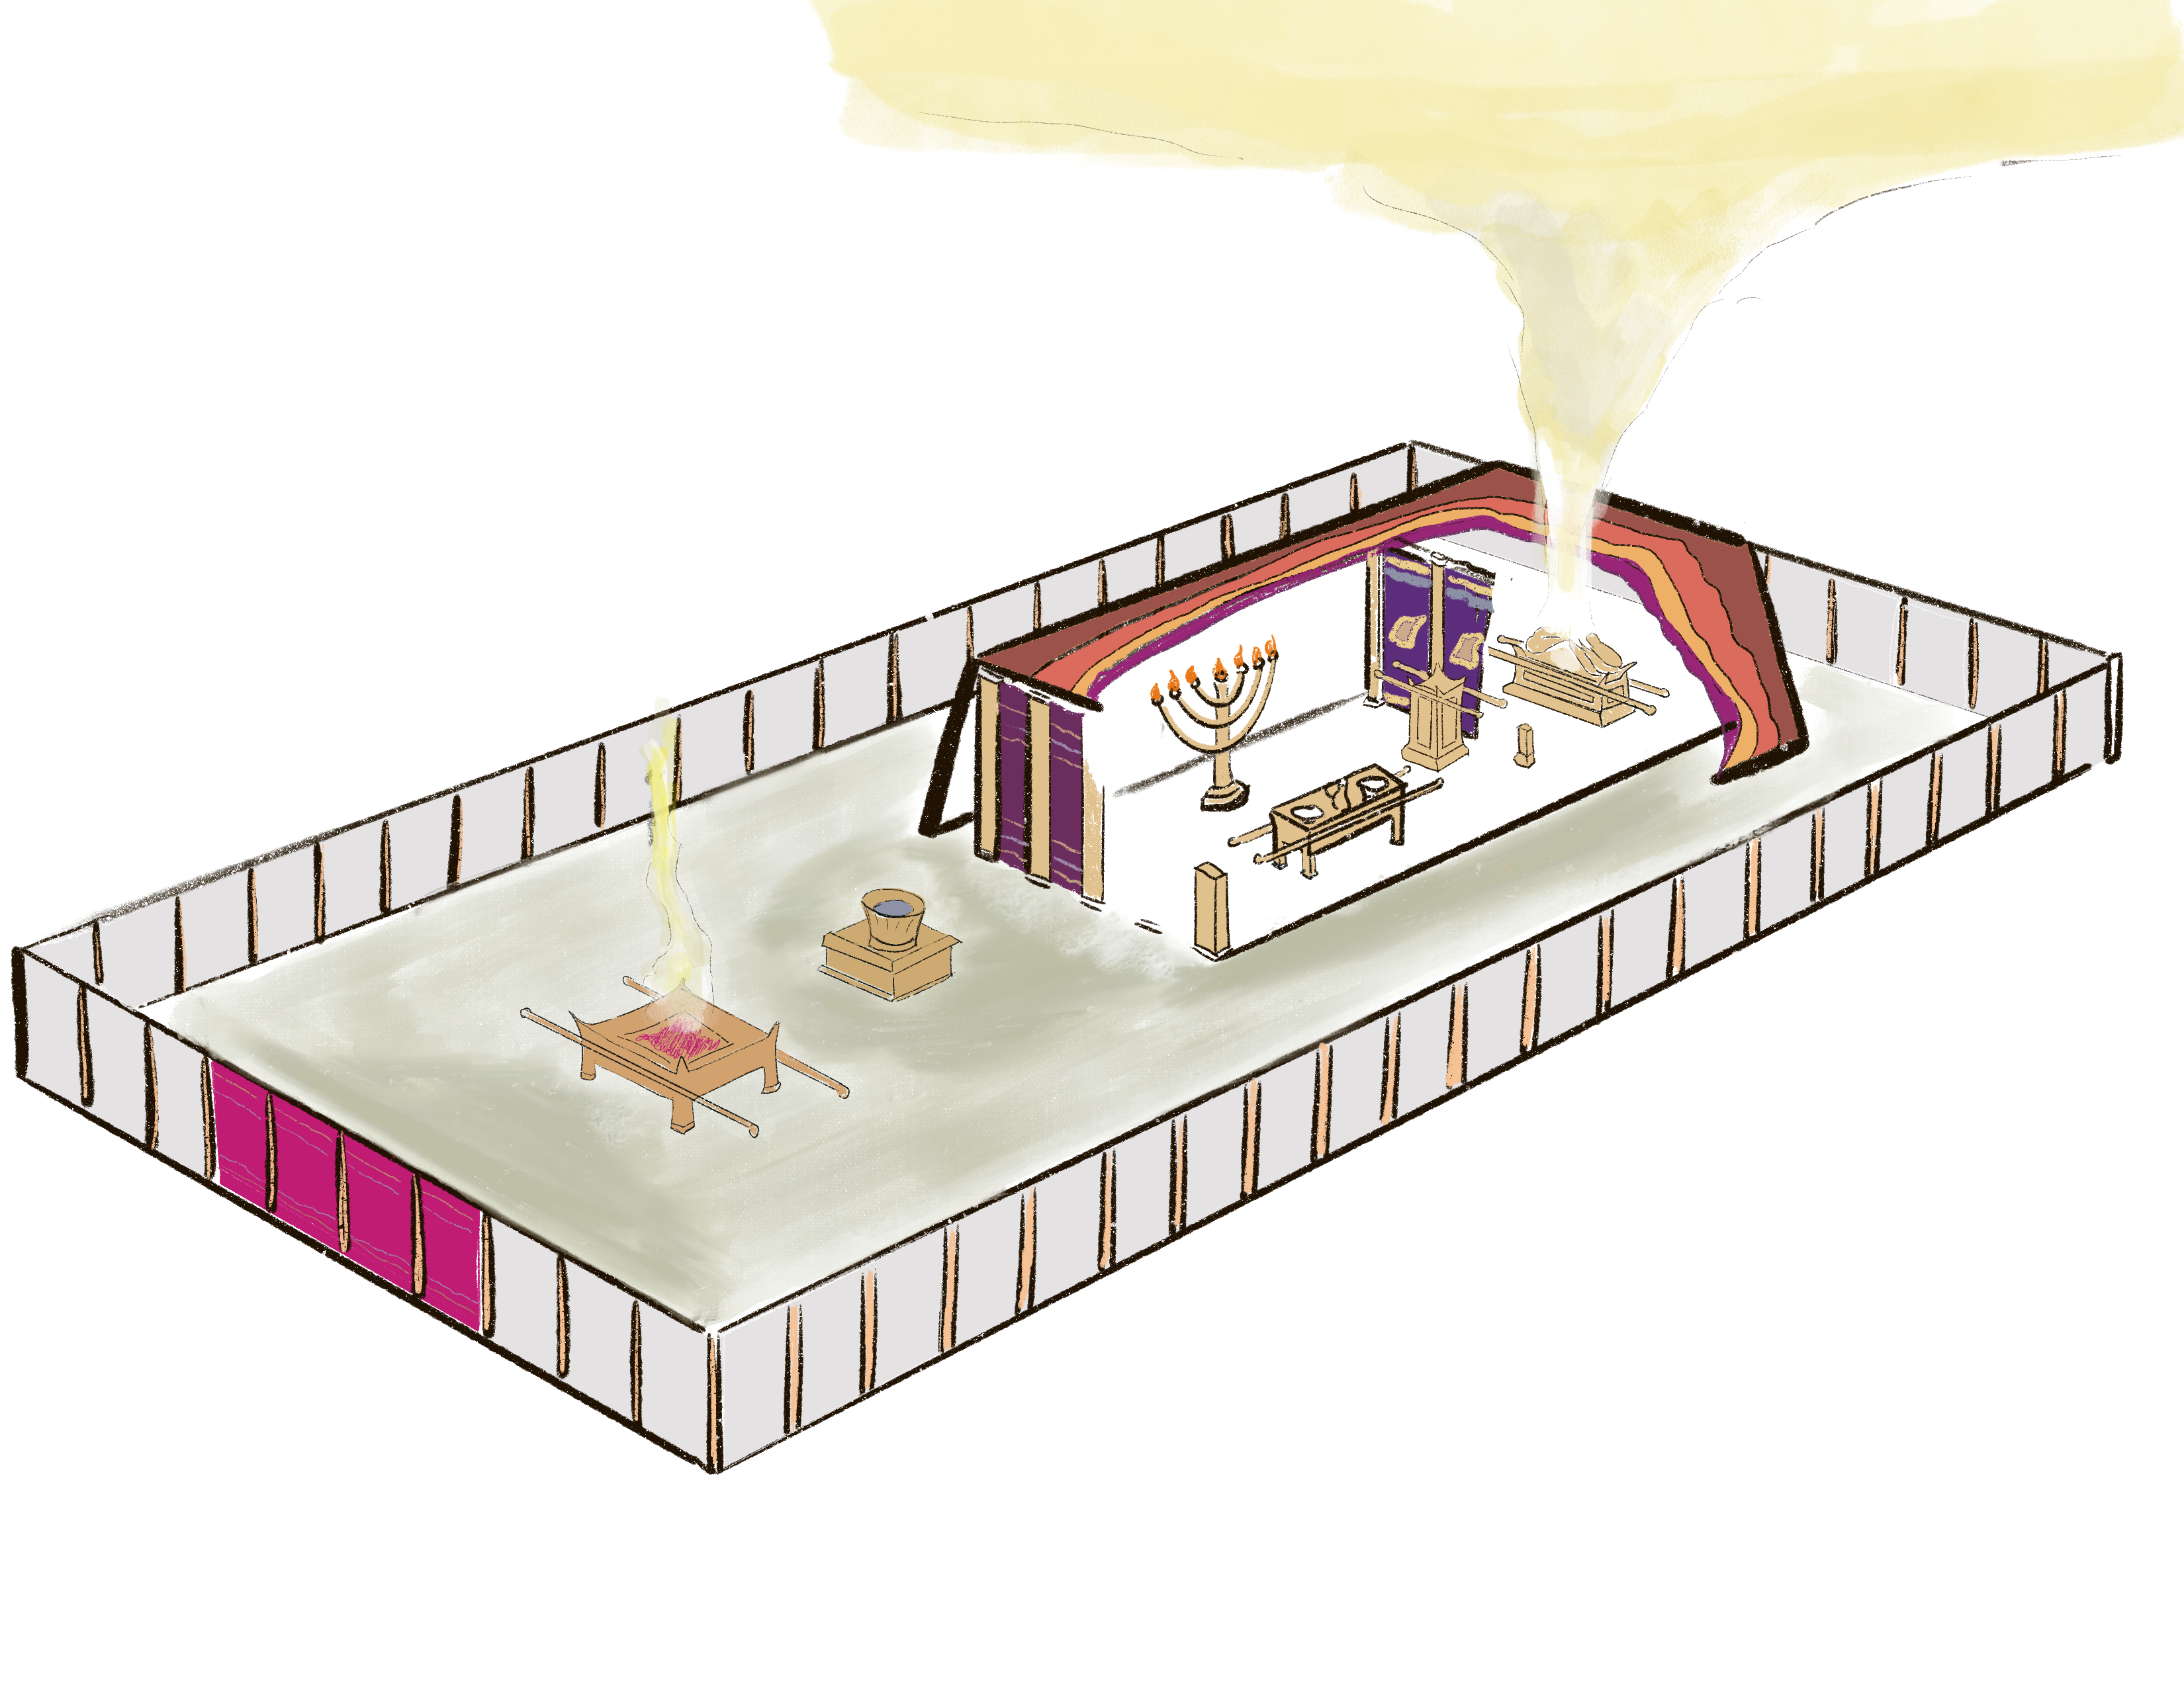
Ex. 40:34 Then the cloud covered the tent of meeting, and the glory of the Lord filled the tabernacle. 35 Moses was not able to enter the tent of meeting because the cloud had settled on it, and the glory of the Lord filled the tabernacle.
NASB

Slide 3
Lev. 1:1 Then the Lord called to Moses and spoke to him from the tent of meeting …
NASB

Slide 4
Lev. 9:22 Then Aaron lifted up his hands toward the people and blessed them, and he stepped down after making the sin offering and the burnt offering and the peace offerings. 23 Moses and Aaron went into the tent of meeting. When they came out and blessed the people, the glory of the Lord appeared to all the people.
NASB

Slide 5
Sweet Savor
Burnt offering
Grain offering
Peace offering
Expiation
Sin offering
Guilt offering

Slide 6
The Peace Offering: Celebrating Peace with God
HOW? (The Procedure)
NASB

Slide 7
HOW? (The Procedure)
1) Present Animal

Slide 8
1) Present Animal
Lev. 3:1 ‘Now if his offering is a sacrifice of peace offerings, if he is going to offer out of the herd, whether male or female, he shall offer it without defect before the Lord.
NASB

Slide 9
1) Present Animal
Lev. 3:1 ‘Now if his offering is a sacrifice of peace offerings, if he is going to offer out of the herd, whether male or female, he shall offer it without defect before the Lord.
sacrifice: , communal sacrifice; worshiper eats of offering (H2285)
NASB

Slide 10
1) Present Animal
Lev. 3:1 ‘Now if his offering is a sacrifice of peace offerings, if he is going to offer out of the herd, whether male or female, he shall offer it without defect before the Lord.
without defect: , free of blemish; blameless, honest, sincere (H9459)
NASB

Slide 11
“Without Defect”
Lev. 3:1 ‘Now if his offering is a sacrifice of peace offerings, if he is going to offer out of the herd, whether male or female, he shall offer it without defect before the Lord.
Deut. 18:13 “You shall be blameless before the Lord your God.
Deut. 32:4 “The Rock! His work is perfect, For all His ways are just;
NASB

Slide 12
HOW? (The Procedure)
1) Present Animal No defect -> blameless

Slide 13
HOW? (The Procedure)
1) Present Animal No defect -> blameless
2) Lean on Animal

Slide 14
2) Lean on Animal
Lev. 3:2 ‘He shall lay his hand on the head of his offering …
NASB

Slide 15
2) Lean on Animal
Lev. 3:2 ‘He shall lay his hand on the head of his offering …
lay: , lean, support (H6164)
Indicates identification
NASB

Slide 16
HOW? (The Procedure)
1) Present Animal No defect -> blameless
2) Lean on Animal Identification

Slide 17
HOW? (The Procedure)
1) Present Animal No defect -> blameless
2) Lean on Animal Identification
3) Slaughter Animal

Slide 18
3) Slaughter Animal
Lev. 3:2 ‘He shall lay his hand on the head of his offering and slay it at the doorway of the tent of meeting, …
life for life: substitution
NASB

Slide 19
HOW? (The Procedure)
1) Present Animal No defect -> blameless
2) Lean on Animal Identification
3) Slaughter Animal Substitution

Slide 20
HOW? (The Procedure)
1) Present Animal No defect -> blameless
2) Lean on Animal Identification
3) Slaughter Animal Substitution
4) Sprinkle Blood (priests)

Slide 21
4) Sprinkle Blood (Priests)
Lev. 3:2 …, and Aaron’s sons the priests shall sprinkle the blood around on the altar.
NASB

Slide 22
4) Sprinkle Blood (Priests)
Lev. 3:2 …, and Aaron’s sons the priests shall sprinkle the blood around on the altar.
Lev. 17:11 ‘For the life of the flesh is in the blood, and I have given it to you on the altar to make atonement for your souls; for it is the blood by reason of the life that makes atonement.’
NASB

Slide 23
HOW? (The Procedure)
1) Present Animal No defect -> blameless
2) Lean on Animal Identification
3) Slaughter Animal Substitution
4) Sprinkle Blood (priests) Atonement

Slide 24
HOW? (The Procedure)
1) Present Animal No defect -> blameless
2) Lean on Animal Identification
3) Slaughter Animal Substitution
4) Sprinkle Blood (priests) Atonement
5) Remove Animal Parts

Slide 25
5) Remove Animal Parts
Lev. 3:3 ‘From the sacrifice of the peace offerings he shall present an offering by fire to the Lord, the fat that covers the entrails and all the fat that is on the entrails, 4 and the two kidneys with the fat that is on them, which is on the loins, and the lobe of the liver, which he shall remove with the kidneys.
NASB

Slide 26
Fat: Best Part
Gen. 45:18 … and I will give you the best of the land of Egypt and you will eat the fat of the land.’
NASB

Slide 27
Entrails, Kidneys, Liver: Seat of Emotions
Psa. 103:1 Bless the Lord, O my soul, And all that is within me (entrails), bless His holy name.
Job 19:27 … My heart (kidneys) faints within me!
Lam. 2:11 My spirit is greatly troubled; My heart (liver) is poured out on the earth
NASB

Slide 28
5) Remove Animal Parts: Sheep
Lev. 3:9 ‘From the sacrifice of peace offerings he shall bring as an offering by fire to the Lord, its fat, the entire fat tail which he shall remove close to the backbone, and the fat that covers the entrails and all the fat that is on the entrails, 10 and the two kidneys with the fat that is on them, which is on the loins, and the lobe of the liver, which he shall remove with the kidneys.
NASB

Slide 29
Fat-Tailed Sheep
Similar to those in Moses’ Palestine?

Slide 30
Fat-Tailed Sheep
From 17th century Jewish encyclopedia, after Herodotus’ 5th century description

Slide 31
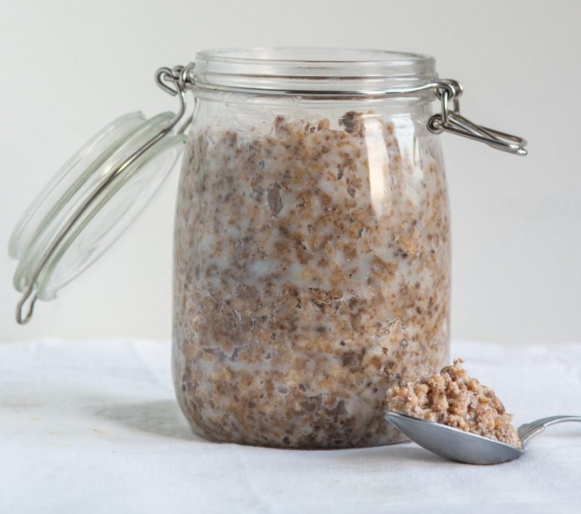
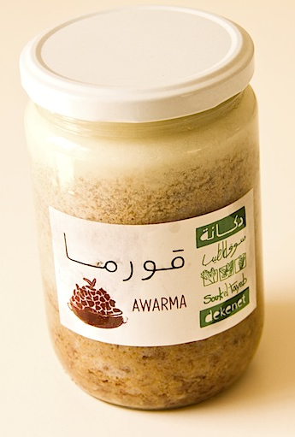
“Awarma”
Arab condiment made from sheep tail

Slide 32
Fat-Tailed Sheep
Similar to those in Moses’ Palestine?

Slide 33
HOW? (The Procedure)
1) Present Animal No defect -> blameless
2) Lean on Animal Identification
3) Slaughter Animal Substitution
4) Sprinkle Blood (priests) Atonement
5) Remove Animal Parts Best, emotion

Slide 34
HOW? (The Procedure)
1) Present Animal No defect -> blameless
2) Lean on Animal Identification
3) Slaughter Animal Substitution
4) Sprinkle Blood (priests) Atonement
5) Remove Animal Parts Best, emotion
6) Burn Animal Parts (priests)

Slide 35
6) Burn Animal Parts (Priests)
Lev. 3:5 ‘Then Aaron’s sons shall offer it up in smoke on the altar on the burnt offering, which is on the wood that is on the fire; it is an offering by fire of a soothing aroma to the Lord.
Lev. 3:16 ‘The priest shall offer them up in smoke on the altar as food, an offering by fire for a soothing aroma; all fat is the Lord’s. 17 ‘It is a perpetual statute throughout your generations in all your dwellings: you shall not eat any fat or any blood.’”
NASB

Slide 36
HOW? (The Procedure)
1) Present Animal No defect -> blameless
2) Lean on Animal Identification
3) Slaughter Animal Substitution
4) Sprinkle Blood (priests) Atonement
5) Remove Animal Parts Best, emotion
6) Burn Animal Parts (priests) Best, emotion

Slide 37
HOW? (The Procedure)
1) Present Animal No defect -> blameless
2) Lean on Animal Identification
3) Slaughter Animal Substitution
4) Sprinkle Blood (priests) Atonement
5) Remove Animal Parts Best, emotion
6) Burn Animal Parts (priests) Best, emotion
7) Communal Meal

Slide 38
7) Communal Meal
Lev. 7:15 ‘Now as for the flesh of the sacrifice of his thanksgiving peace offerings, it shall be eaten on the day of his offering; he shall not leave any of it over until morning. 16 ‘But if the sacrifice of his offering is a votive or a freewill offering, it shall be eaten on the day that he offers his sacrifice, and on the next day what is left of it may be eaten; 17 but what is left over from the flesh of the sacrifice on the third day shall be burned with fire.
NASB

Slide 39
7) Communal Meal: Portion for Priests
Lev. 7:30 … He shall bring the fat with the breast, that the breast may be presented as a wave offering before the Lord. 31 ‘The priest shall offer up the fat in smoke on the altar, but the breast shall belong to Aaron and his sons. 32 ‘You shall give the right thigh to the priest as a contribution from the sacrifices of your peace offerings. 33 ‘The one among the sons of Aaron who offers the blood of the peace offerings and the fat, the right thigh shall be his as his portion.
NASB

Slide 40
HOW? (The Procedure)
1) Present Animal No defect -> blameless
2) Lean on Animal Identification
3) Slaughter Animal Substitution
4) Sprinkle Blood (priests) Atonement
5) Remove Animal Parts Best, emotion
6) Burn Animal Parts (priests) Best, emotion
7) Communal Meal Celebrate peace

Slide 41
The Peace Offering: Celebrating Peace with God
WHY? (The Occasions)

Slide 42
WHY? (The Occasions)
1) Thanksgiving/Praise

Slide 43
Thanksgiving/Praise
Lev. 7:11 ‘Now this is the law of the sacrifice of peace offerings which shall be presented to the Lord. 12 ‘If he offers it by way of thanksgiving, then along with the sacrifice of thanksgiving he shall offer unleavened cakes mixed with oil, and unleavened wafers spread with oil, and cakes of well stirred fine flour mixed with oil. 13 ‘With the sacrifice of his peace offerings for thanksgiving, he shall present his offering with cakes of leavened bread. 14 ‘Of this he shall present one of every offering as a contribution to the Lord; it shall belong to the priest who sprinkles the blood of the peace offerings.
NASB

Slide 44
WHY? (The Occasions)
1) Thanksgiving/Praise
2) Vow (Votive)
3) Free will

Slide 45
Votive, Free-Will
Lev. 7:16 ‘But if the sacrifice of his offering is a votive or a freewill offering, it shall be eaten on the day that he offers his sacrifice, and on the next day what is left of it may be eaten; 17 but what is left over from the flesh of the sacrifice on the third day shall be burned with fire.
NASB

Slide 46
Thanksgiving Offerings
Psa. 54:6 Willingly I will sacrifice to You;
I will give thanks to Your name, O Lord, for it is good.
7 For He has delivered me from all trouble,
And my eye has looked with satisfaction upon my enemies.
Psa. 56:12 Your vows are binding upon me, O God;
I will render thank offerings to You.
13 For You have delivered my soul from death,
Indeed my feet from stumbling,
So that I may walk before God
In the light of the living.
NASB

Slide 47
E.g. Elkanah & Hannah
1Sam. 1:3 Now this man would go up from his city yearly to worship and to sacrifice to the Lord of hosts in Shiloh. … 4 When the day came that Elkanah sacrificed, he would give portions to Peninnah his wife and to all her sons and her daughters; 5 but to Hannah he would give a double portion, for he loved Hannah, but the Lord had closed her womb.
NASB

Slide 48
E.g. Elkanah & Hannah
1Sam. 1:11 She made a vow saying, “O Lord of hosts, if you will look with compassion on the suffering of your female servant, remembering me and not forgetting your servant, and give a male child to your servant, then I will dedicate him to the Lord all the days of his life. His hair will never be cut.”
…
24 Once she had weaned him, she took him up with her, along with three bulls, an ephah of flour, and a container of wine. She brought him to the Lord’s house at Shiloh, even though he was young. 25 Once the bull had been slaughtered, they brought the boy to Eli.
NET

Slide 49
Dedication of Temple
1Kings 8:62 Now the king and all Israel with him offered sacrifice before the Lord. 63 Solomon offered for the sacrifice of peace offerings, which he offered to the Lord, 22,000 oxen and 120,000 sheep. So the king and all the sons of Israel dedicated the house of the Lord.
NET

Slide 50
WHY? (The Occasions)
1) Thanksgiving/Praise
2) Vow (Votive)
3) Free will
Variants:
Ordination (Ex. 29)
Passover (Deut. 16)

Slide 51
Lord’s Supper
Ex. 24:5 [Moses] sent young men of the sons of Israel, and they offered burnt offerings and sacrificed young bulls as peace offerings to the Lord. … 8 So Moses took the blood and sprinkled it on the people, and said, “Behold the blood of the covenant, which the Lord has made with you in accordance with all these words.”
Lk. 22: 20 And in the same way He took the cup after they had eaten, saying, “This cup which is poured out for you is the new covenant in My blood.
NASB

Slide 52
Warnings against uncleanness
Lev. 7:20 ‘But the person who eats the flesh of the sacrifice of peace offerings which belong to the Lord, in his uncleanness, that person shall be cut off from his people. 21 ‘When anyone touches anything unclean, whether human uncleanness, or an unclean animal, or any unclean detestable thing, and eats of the flesh of the sacrifice of peace offerings which belong to the Lord, that person shall be cut off from his people.’”
NASB

Slide 53
Unique Features of Peace Offering
Optional
Animals can be Male or Female
Offeror eats from the sacrifice
Celebration at the end of the ritual

Slide 54
The Peace Offering: Celebrating Peace with God
So WHAT? (The Applications)

Slide 55
So WHAT? (The Applications)
Give God our best

Slide 56
God Should Get the Best
Mal. 1:7 “You are presenting defiled food upon My altar. But you say, ‘How have we defiled You?’ In that you say, ‘The table of the Lord is to be despised.’ 8 “But when you present the blind for sacrifice, is it not evil? And when you present the lame and sick, is it not evil? Why not offer it to your governor? Would he be pleased with you? Or would he receive you kindly?” says the Lord of hosts.
NASB

Slide 57
So WHAT? (The Applications)
Give God our best
Make sure to have peace with God
Only possible through death of a blameless substitute

Slide 58
Peace Through Jesus’ Sacrifice
Eph. 2:13 But now in Christ Jesus you who formerly were far off have been brought near by the blood of Christ. 14 For He Himself is our peace, who made both groups into one and broke down the barrier of the dividing wall,
NASB

Slide 59
Peace Through Jesus’ Sacrifice
Col. 1:19 For it was the Father’s good pleasure for all the fullness to dwell in Him, 20 and through Him to reconcile all things to Himself, having made peace through the blood of His cross; through Him, I say, whether things on earth or things in heaven.
NASB

Slide 60
So WHAT? (The Applications)
Give God our best
Make sure to have peace with God
Only possible through death of a blameless substitute
Celebrate peace with God!

Slide 61
Celebrate Peace with God!
Heb. 13:10 We have an altar from which those who serve the tabernacle have no right to eat. … 15 Through Him then, let us continually offer up a sacrifice of praise to God, that is, the fruit of lips that give thanks to His name.
NASB

Slide 62
So WHAT? (The Applications)
Give God our best
Make sure to have peace with God
Only possible through death of a blameless substitute
Celebrate peace with God!

