Slide 1
Sin offering
Lev 4:1-5:13
GBC

Slide 2
The law in ancient history clearly revealed that sins of any kind angered God, deprived him of his due, defiled his sanctuary, and thus put a barrier between the guilty and God.
Gordan Wenham

Slide 3
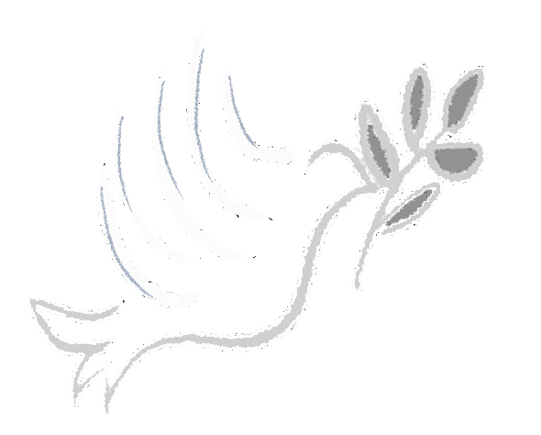
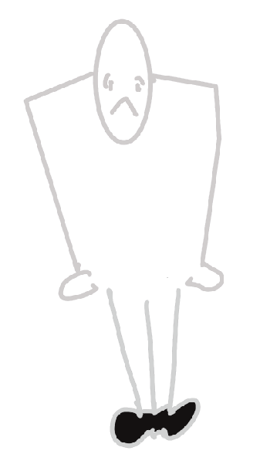
Voluntary
Burnt offering
Grain offering
Peace offering
Mandatory
Sin offering
Guilt offering

Slide 4
Offerings | Christ typified | Applications | NT references
Burnt offering | He gave it all | “all on the altar” | Rom 12:1
Grain offering | His perfect and sinless life | “dedication” “thanksgiving” “Consecration” “Giving back” | Heb 13:15 Col 4:2 Matt 5:13
Peace offering | He is our Peace | “life of fellowship” “life of thanksgiving” | Acts 2:42
Sin offering
Guilt offering

Slide 5
Sinner(s) | Offering | Priest duty | Promise
Anointed Priest | Bull | To make atonement | They shall be forgiven
Whole congregation | Bull
A leader | Male goat
Anyone among the common people | Female goat/Lamb
Specific unpremeditated sins | Lamb/Turtle doves/Pigeons/fine flour

Slide 6
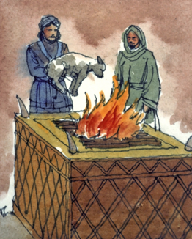
CHRIST
Burnt offering
Grain offering
Peace offering
Sin offering
Guilt offering

Slide 7
Christ, our sin offering
Dealing with sin is Mandatory
2 Corinthians 5:21 “He made Him who knew no sin to be sin on our behalf, so that we might become the righteousness of God in Him.”
Romans 8:3 For what the Law could not do, weak as it was through the flesh, God did: sending His own Son in the likeness of sinful flesh and as an offering for sin, He condemned sin in the flesh,"

Slide 8
Christ, our sin offering
Dealing with sin is Mandatory
John 1:29 “The next day he saw Jesus coming to him and said, "Behold, the Lamb of God who takes away the sin of the world!"
1 Pet 2:24 and He Himself bore our sins in His body on the cross, so that we might die to sin and live to righteousness; for by His wounds you were healed."

Slide 9
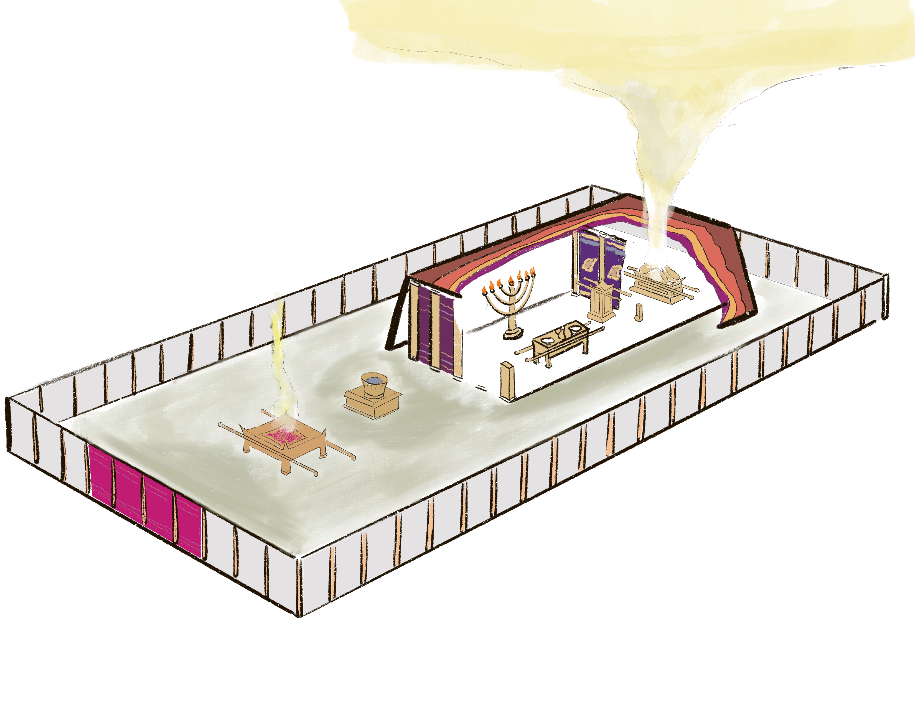
Christ, our sin offering
The sprinkling of blood
Holy of Holies
Holy Place
Bronze Laver
Bronze Altar

Slide 10
Christ, our sin offering
The sprinkling of blood
Heb 9:7, 11-12
" ⁷ but into the second, only the high priest enters once a year, not without taking blood, which he offers for himself and for the sins of the people committed in ignorance.
¹¹ But when Christ appeared as a high priest of the good things to come, He entered through the greater and more perfect tabernacle, not made with hands, that is to say, not of this creation;
¹² and not through the blood of goats and calves, but through His own blood, He entered the holy place once for all, having obtained eternal redemption."

Slide 12
Christ, our sin offering
Outside the camp
Lev 4:11-12
¹¹ 'But the hide of the bull and all its flesh with its head and its legs and its entrails and its refuse,
¹² that is, all the rest of the bull, he is to bring out to a clean place outside the camp where the ashes are poured out, and burn it on wood with fire; where the ashes are poured out it shall be burned."

Slide 13
Christ, our sin offering
Outside the camp
Heb 13:12-13
12 Therefore Jesus also, that He might sanctify the people through His own blood, suffered outside the gate.
13 So, let us go out to Him outside the camp, bearing His reproach."

Slide 14
Principles for today…
God hates sin
Keep short accounts with God
Be sure your sin will find you out
GOSPEL is the solution

