Slide 2
The Priesthood Then and Now
Inauguration of the Priestly Service
Leviticus 9

Slide 3
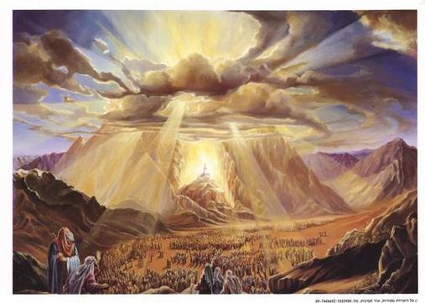
Exod. 19:5,6 “If you will indeed obey My voice and keep My covenant, then you shall be My own possession among all the peoples... and you shall be to Me a kingdom of priests and a holy nation”

Slide 4
Outline
Laws of Priesthood (8:1-10:20)
Consecration of Priests (8:1-36)
Inauguration of the priestly service (9:1-24)
Nadab and Abihu’s sacrilegious service (10:1-20)

Slide 5
I. Old Testament Priesthood
A. Formally established with the consecration of Aaron &
His sons in Lev. 8
B. Why Aaron? Why wasn’t he punished for making the
golden calf & leading the people into idolatry?
“It is safe to say that God used an unlikely person to serve in an important role. Aaron, the man who led the Israelites astray to worship a golden calf, was the very man God chose to lead Israel in worship of the Lord...

Slide 6
I. Old Testament Priesthood
This pattern is often observed in Scripture. Many times, God uses the least likely to accomplish tasks for His glory:”
David
Mary Magdalene
Peter
Paul
1Cor. 1:27 “God chose the foolish things of the world to shame the wise; God chose the weak things of the world to shame the strong.” gotquestions.org

Slide 7
I. Old Testament Priesthood
C. Aaron and sons offer sacrifices “that the glory of
the Lord may appear to you” Lev. 9
vs 8-14 Aaron offered sin & burnt offerings for
himself.
vs 15-18 he offered sin, burnt, grain & peace
offerings for the people.

Slide 8
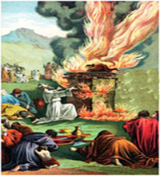
vs 23-24 The promise of God’s glory appearing to them was fulfilled and their offering was consumed by fire from before the Lord signifying that God had accepted Aaron’s sacrifices.

Slide 9
What might the Israelites have learned from these experiences?
- They must have experienced a deeper awareness of
God’s holiness and awesome power.
- Likely gained a deeper appreciation of God’s grace and
mercy in appointing a man like Aaron to be the high priest.
- Perhaps they realized from the outset that the Aaronic
priesthood was not perfect.
- Maybe they began to question if there was a better
priesthood!

Slide 10
II. New Testament Priesthood
The Aaronic priesthood was fulfilled & eclipsed
by Christ as our great High Priest. Heb. 7:22-8:1

Slide 11
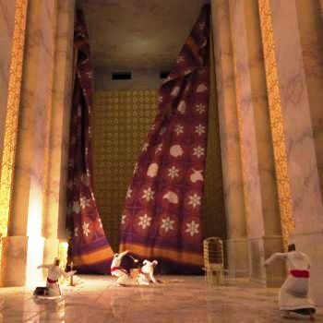
II. New Testament Priesthood
B. Now all believers in Christ are priests. Heb. 10:19-22,
Rev. 1:6

Slide 12
II. New Testament Priesthood
Randy Amos: “There should be a visible expression of the truth of the priesthood of believers. A clergy laity system in which only the clergy can pray, teach, serve and lead in worship is not giving full expression to the gospel. Christ’s blood gives equal access to every true believer. It is not the concept of clergy which the NT has a problem, but laity. In many churches the laity does only three things: ‘pay, pray and obey’.
All believers are clergy, priests, not by seminary training, or ordination but by Christ’s blood.”

Slide 13
How do NT believers fulfill our role as priests?
1Pet 2:5 “You also, as living stones, are being built up as a spiritual house for a holy priesthood, to offer up spiritual sacrifices acceptable to God through Jesus Christ.”
1Pet. 2:9 But you are a chosen race, a royal priesthood, a holy nation, a people for God's own possession, that you may proclaim the excellencies of Him who has called you out of darkness into His marvelous light;

Slide 14
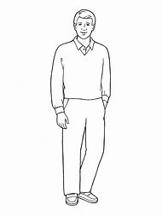
What are some spiritual sacrifices that we can offer to God?
Romans 12:1 “...present your bodies a living & holy sacrifice...”
- my mind 2Cor. 10:5
- my eyes Job 31:1, Mat. 5:27,28, Heb. 12:2
- my ears Lev. 8:23
- my mouth Heb. 13:15, Psa. 19:14
- my heart Mat. 22:37
- my hands Heb. 13:16, Col. 3:23
- my back pocket Heb. 13:16
- my feet Rom 10:15
Drawing Pro

Slide 15
E. Some guidelines and conditions on the exercise of our priesthood.
Recognize differing gifts Rom. 12:6, 1 Cor. 12:7.

Slide 16
Ministry Opportunities at Hillview
Accounting Administration Announcements Annual Retreat Audio Visual / Sound Room Baptistry preparation Bible Study Book Nook Breaking of Bread Budget Building Maintenance Bulletin Publishing Chapel Calendar Chapel Cleaning Chapel Decorations Child Care Children's Clubs College Ministry Consumables Decorations Elders' Administration | Foundation Series Gospel Pioneers Greeter Guest Speaker Hospitality Helping Hands High School ministry Hospitality Teams Ladies’ Teams Men's Ministries Mission Conferences Missions "Load lifter" Missionary Correspondence Music Neighborhood evangelism Nursery Office People in Need Pew Materials Prayer Time Preaching Rotation | Resource Room Responsibility List Secretarial work Small Group Fellowships Snack Rotation Sound Room Special Events Special Seminars Sunday School Sunday snack rotation Teacher (Adult) Transportation Treasury University of Acts Ushering Video Production Visitation Web Site Washing linens Women's Ministries

Slide 17
E. Some guidelines and conditions on the exercise of our priesthood.
2. Recognize differing roles.
a) Both men & women have an equal standing
before God with regard to salvation. Gal. 3:28
b) God calls some men to serve as overseers &
authoritative teachers of the Word. 1Tim. 3:1-7
c) Women are not to teach or exercise authority over
a man. 1Tim 2:12-14

Slide 18
E. Some guidelines and conditions on the exercise of our priesthood.
2. Recognize differing roles.
d) The men of the church are to speak out in the
public meetings of the church so as to direct the
congregation. 1Tim. 2:8, 1Cor. 14:34-37
e) A woman’s perspective on the Lord’s Supper
f) Women ministering to other women Titus 2:3-5

Slide 19
“The priesthood of all believers is a truth that should be understood, believed, and joyfully practiced by every Christian.”
Bill MacDonald

