Slide 2
The death of Nadab and Abihu
Leviticus chapter 10
“... I will be treated as holy ...”
3/1/2020

Slide 3
“... I will be treated as holy ...” The death of Nadab and Abihu
The Gravity of God
Get up lad, get up
Glorify God in conflict

Slide 4
“... I will be treated as holy ...” The death of Nadab and Abihu
The Gravity of God

Slide 5
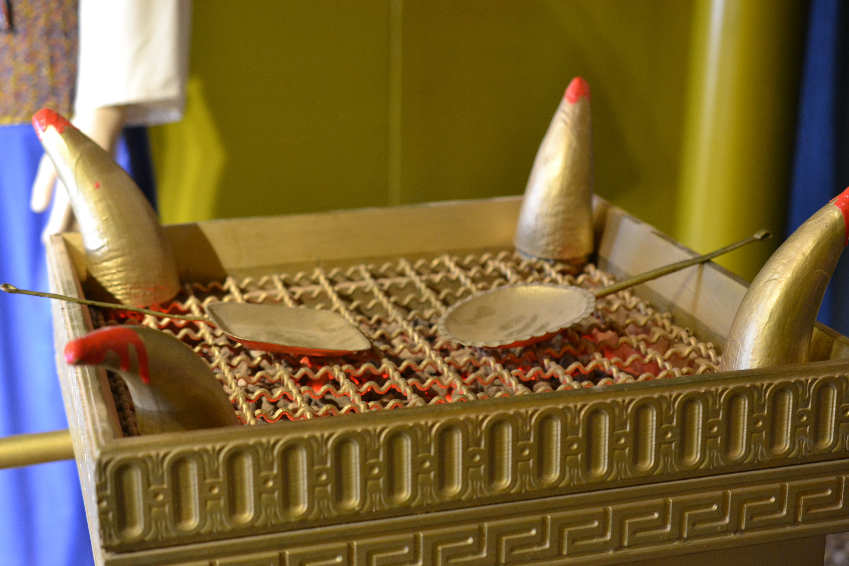

Slide 6
“... I will be treated as holy ...” The death of Nadab and Abihu
The Gravity of God
Get up lad, get up

Slide 7
“... I will be treated as holy ...” The death of Nadab and Abihu
The Gravity of God
Get up lad, get up
Glorify God in conflict

Slide 8
Procedure:
Blood not brought into the “Holy Place” sin offering should have been eaten

Slide 9
Lev 10:19 Then Aaron answered Moses, “Today my sons presented both their sin offering and their burnt offering to the Lord. And yet this tragedy has happened to me. If I had eaten the people’s sin offering on such a tragic day as this, would the Lord have been pleased?”
New Living Translation

Slide 10
Glorify God in Conflict
Focusing on God is the key to resolving conflict constructively. When we remember his mercy and draw on his strength we invariably see things more clearly and respond to conflict more wisely. In doing so, we can find far better solutions to our problems. At the same time, we can show others that there really is a God and that he delights in helping us do things we could never do on our own
The Peace Maker, Ken Sande

