Slide 1
The Trumpet Judgments
Revelation 8-9

Slide 2
Matt. 24:21 “For then there will be a great tribulation, such as has not occurred since the beginning of the world until now, nor ever will.”
Matt. 24:22 “Unless those days had been cut short, no life would have been saved; but for the sake of the elect those days will be cut short.”

Slide 4
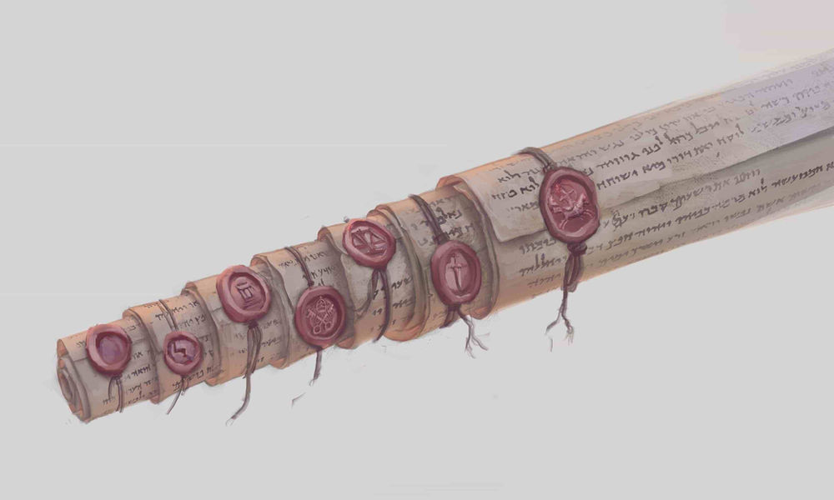

Slide 5
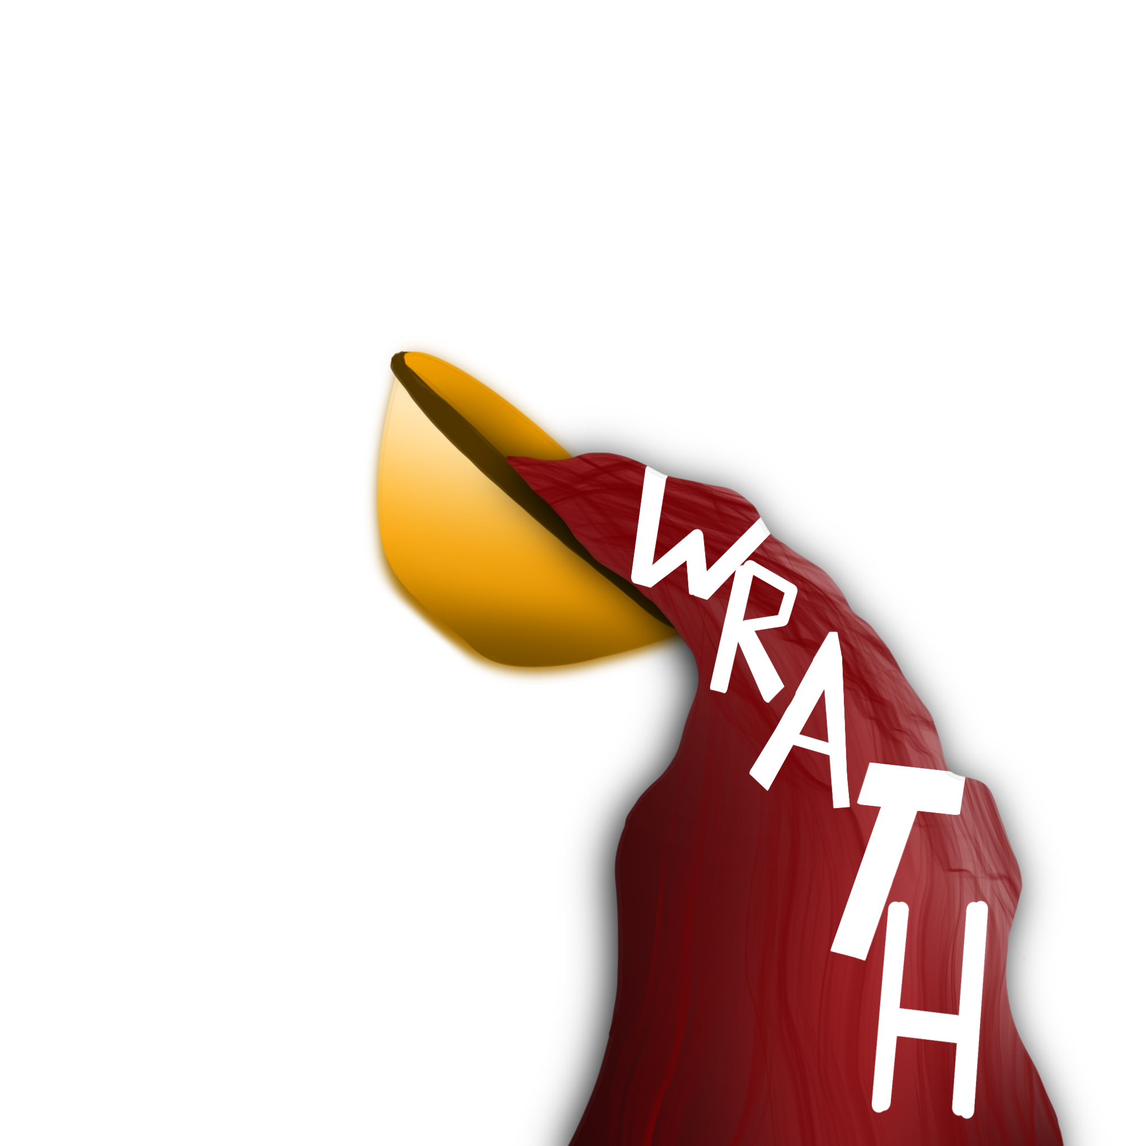
1
2
3
4
5
6
7
Seals that are “broken”
1
2
Intensity
3
Trumpets that are “sounded”
4
5
6
Bowls that are “poured”
7

Slide 6
Hail and fire mixed with blood
1/3 trees burned
1
1/3 earth burned
Rev 8:7
Vegetation Struck
all the green grass burned

Slide 7
something like a great mountain thrown
1/3 of the sea became blood
2
1/3 of the sea creatures died
Rev 8:8-9
The Seas Struck
1/3 of the ships destroyed

Slide 8
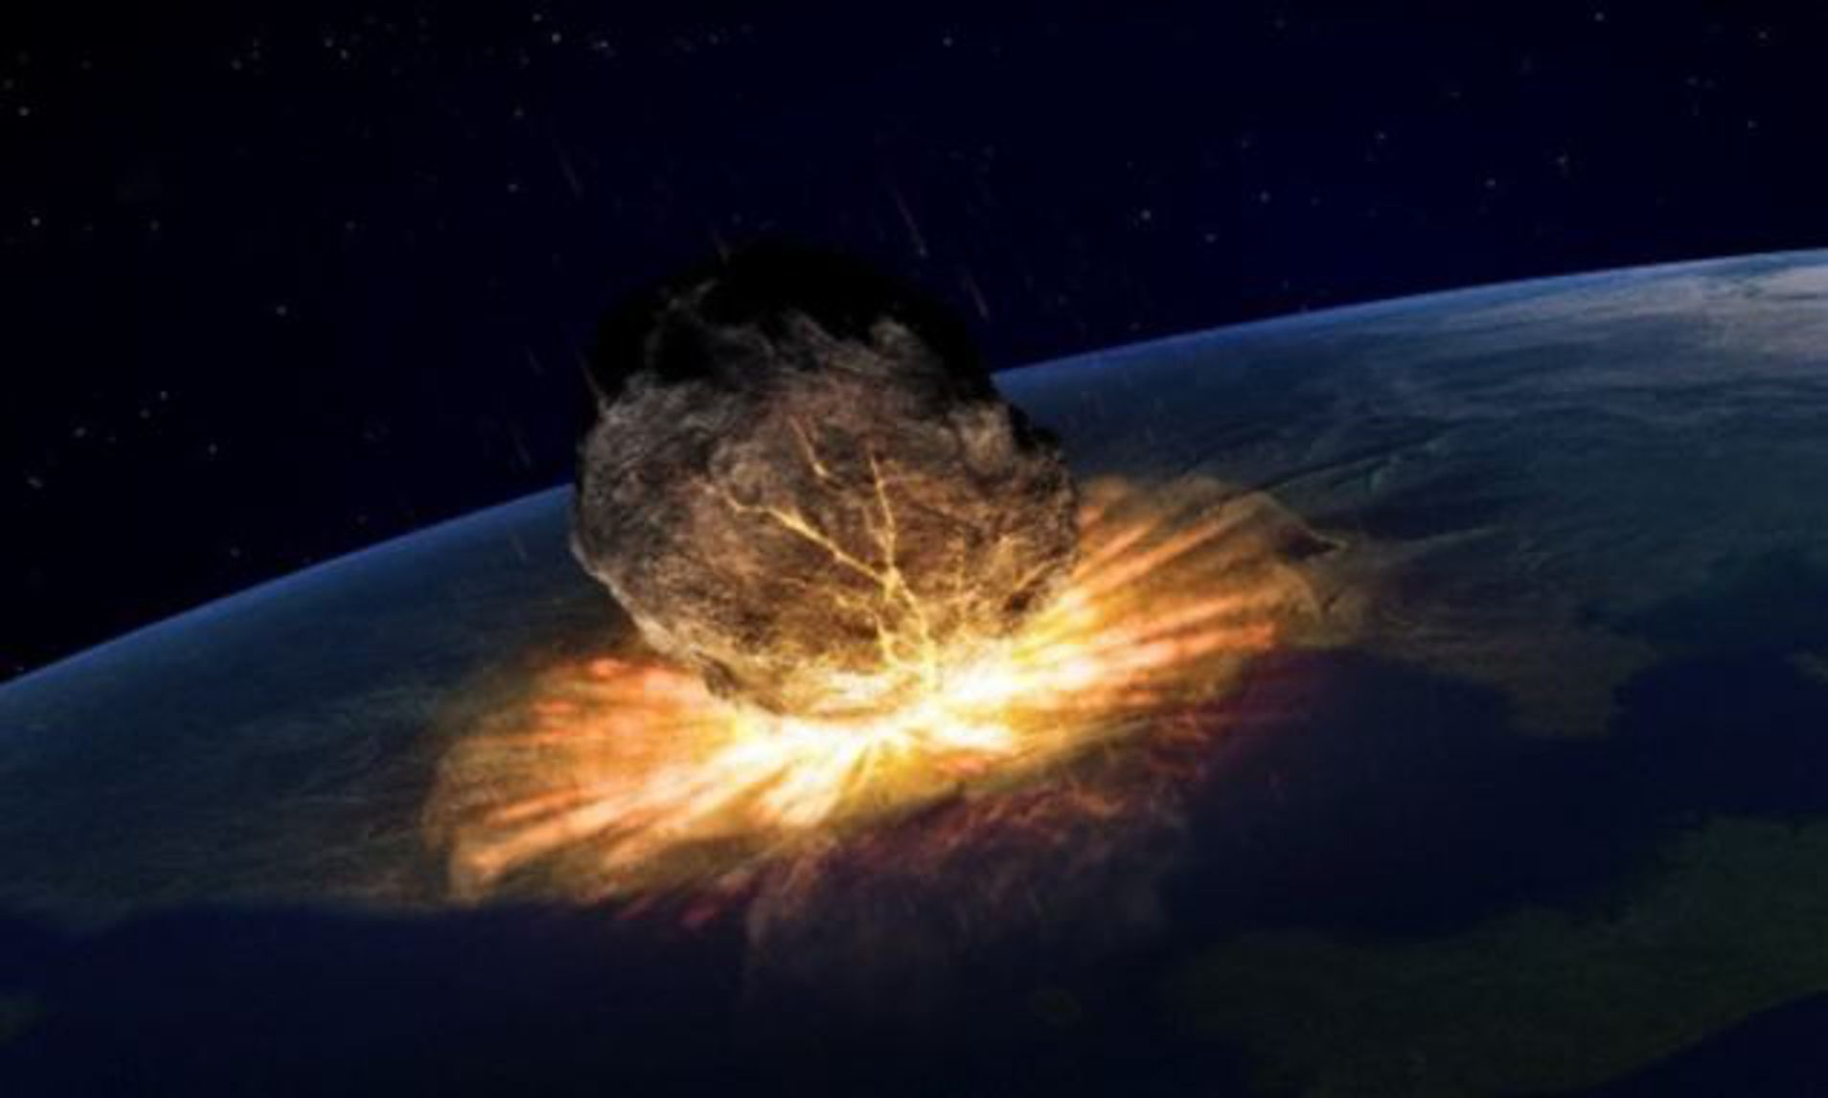

Slide 9
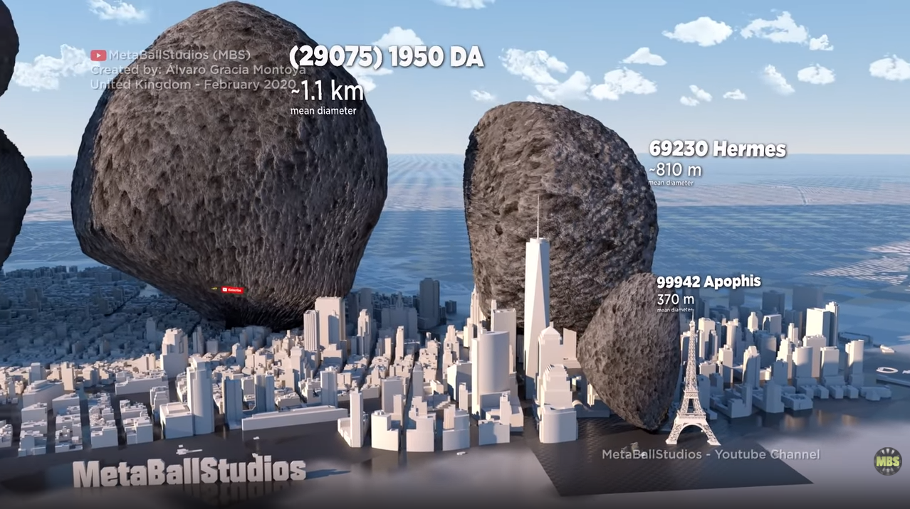

Slide 10
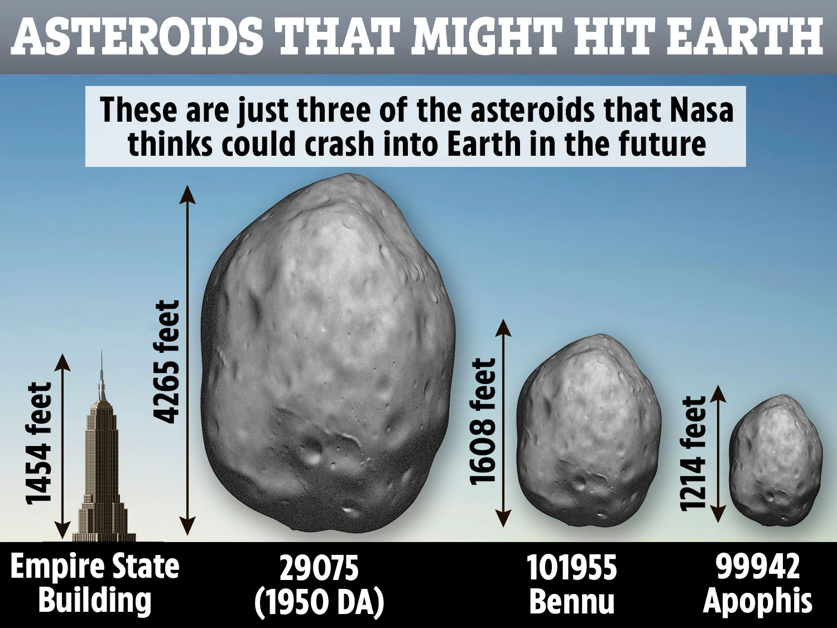

Slide 11
something like a great mountain thrown
1/3 of the sea became blood
2
1/3 of the sea creatures died
Rev 8:8-9
The Seas Struck
1/3 of the ships destroyed

Slide 12
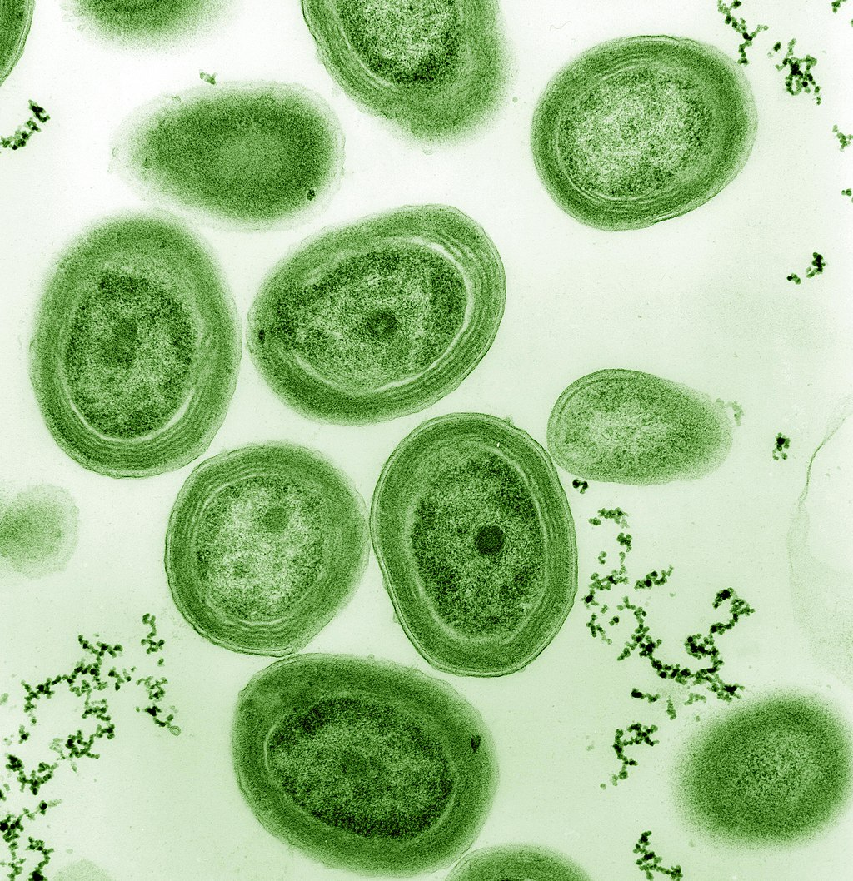
Prochlorococcus
Prochlorococcus, releases 20% of the oxygen in our entire biosphere. That’s a higher percentage than all of the tropical rainforests on land combined.
Dr. Sylvia A. Earle, a National Geographic Explorer, has estimated that Prochlorococcus provides the oxygen for one in every five breaths we take.

Slide 13
something like a great mountain thrown
1/3 of the sea became blood
2
1/3 of the sea creatures died
Rev 8:8-9
The Seas Struck
1/3 of the ships destroyed

Slide 14
a great star fell from heaven
1/3 of the fresh water becomes bitter (Wormwood)
3
Rev 8:10-11
many men died
Fresh waters struck

Slide 15
1/3 of sun, moon, stars struck
4
Luke 21:25 “There will be signs in sun and moon and stars, and on the earth dismay among nations,…
Rev 8:12
Fresh waters struck

Slide 16
1
2
3
4
5
6
7
Seals that are “broken”
1
2
3
Trumpets that are “sounded”
4
5
6
Bowls that are “poured”
The 3 “woes”
7

Slide 17
“Star from heaven” fallen
Bottomless pit opened
DEMONS (Locusts) RELEASED
Their Job:
- To hurt people for 5 months and not kill
Their description:
Like horses prepared for battle
Crowns like gold on their head
Faces like faces of men
Hair like hair of women
Teeth like teeth of lions
Breastplate like breastplates of iron
Wings sounded like that of chariots
Tails like scorpions
”Abaddon” or “Apollyon”
5
Rev 9:1-12
Demons released

Slide 18
Four angels at Euphrates released
200 million strong army of horsemen
6
Rev 9:13-19
Four angels released

Slide 19
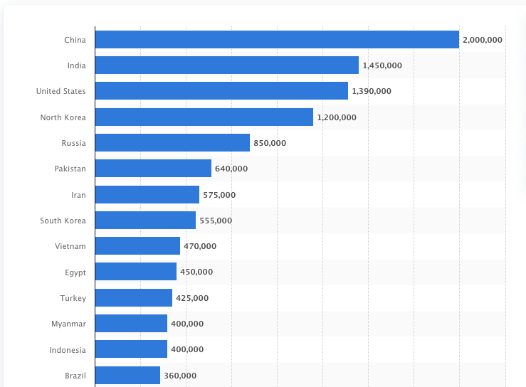
Largest armies in the world ranked by active military personnel in 2022

Slide 20
Four angels at Euphrates released
200 million strong army of horsemen
6
Their Job:
- To kill 1/3 of the mankind
Their description:
- color of the breastplate: Fire, Hyacinth, brimstone
- head of the horses were like that of lions
- out their mouths came fire, smoke and brimstone
- power was in their mouth and tails
- tails were like serpents and had heads
Rev 9:13-19
Four angels released

Slide 21
Rev. 9:20 The rest of mankind, who were not killed by these plagues, did not repent of the works of their hands, so as not to worship demons, and the idols of gold and of silver and of brass and of stone and of wood, which can neither see nor hear nor walk;
Rev. 9:21 and they did not repent of their murders nor of their sorceries nor of their immorality nor of their thefts.

Slide 22
2Pet. 3:9 The Lord is not slow about His promise, as some count slowness, but is patient toward you, not wishing for any to perish but for all to come to repentance.

Slide 23
Trumpet Judgment
1
Vegetation Struck
5
The Locust from Bottomless Pit
2
The Seas Struck
The Angels from Euphrates
6
3
Waters Struck
An Interlude (Rev 10-13)
4
The Heaves Struck
7
Waters Struck
Notes:
Hi Dave - here’s another idea how to use them…. for a given focused message, say the message on the seven seals…
The entire composition in centered, but slightly to the right for effect.
For each seal, I Inserted the numbers in white for contrast
Shape is skewed triangle, a tad transparent dark color for effect (skew triangle done by adjusting the control point at the apex)

Slide 24
Notes:
Hi Dave - here’s another idea how to use them : Opening of the seven-sealed book…with drop shadow

